Slide 1
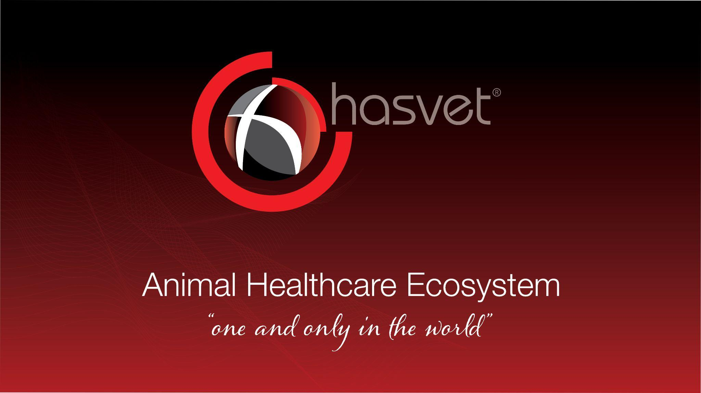
Welcome to
the Animal Health Ecosystem
2025

Slide 2

Hasvet Animal Healthcare Ecosystem accompanies its colleagues on their development and transformation journey, encompassing all components of the global veterinary health sector. These include medical devices, medicines, education, surgical instruments, clinical software systems, industrial clinical equipment, and nutrition solutions.
Founded by veterinarians driven solely by the desire to provide the best for their customers, Hasvet operates with an honest and trust-based business model. Instead of focusing on profit, the founders pursue their work with passion, finding happiness in the peace of mind that comes from doing their job well. Hasvet is more than a company; it is a cohesive family that prioritizes patient care and contributes to the professional growth of veterinarians.
Our commitment to advancing animal welfare and elevating Turkey's animal husbandry to a global leadership position drives us forward. This presentation aims to showcase our journey and the future of the Hasvet Animal Healtcare Ecosystem to our esteemed stakeholders.

Slide 3

Mission
At Hasvet Medikal, we adopt a patient-centered approach to enhance animal health by providing veterinarians with innovative, reliable, and high-quality medical devices and solutions. By placing scientific principles and advanced technology at the core of our services, we strive to improve diagnostic and treatment processes while ensuring animals lead healthier and more comfortable lives.
Vision
With the goal of becoming a global leader in animal health, we aspire to establish Hasvet Medikal as a pioneering brand shaping the future of veterinary medicine worldwide. By focusing on continuous technological advancement and innovation, we are committed to sustainable growth and becoming a trusted partner in the international veterinary sector, guided by our ethical values.

Slide 4
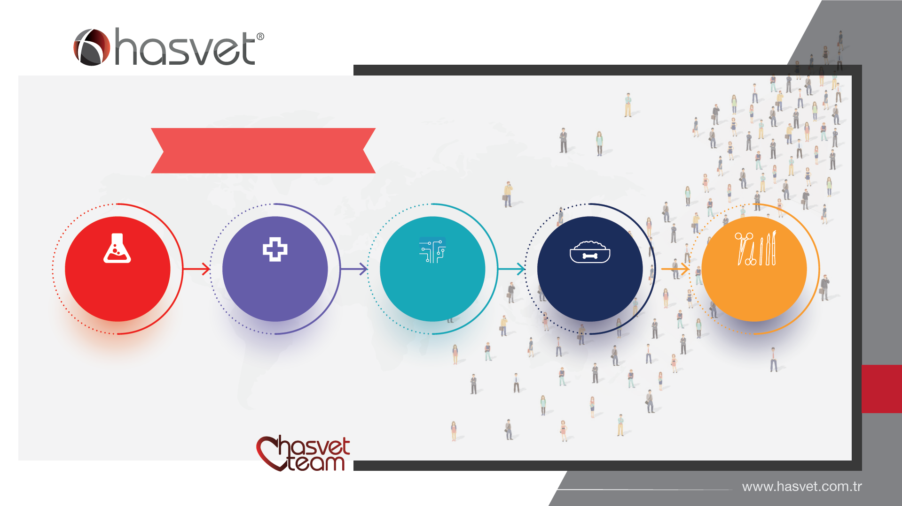
502
600+
180
287
18
21
29
32
57
218
58
202

Slide 5
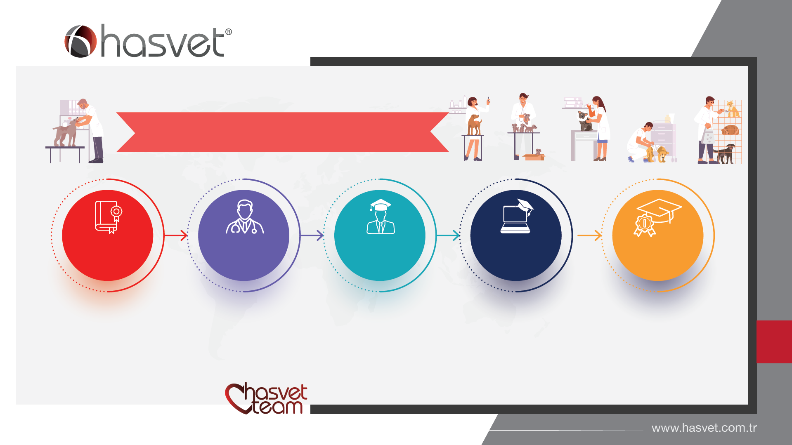
85 Veterinarian
37
21
9
13
5
Undergraduate
Master's Degree
PhD
MBA
Doktorant

Slide 6
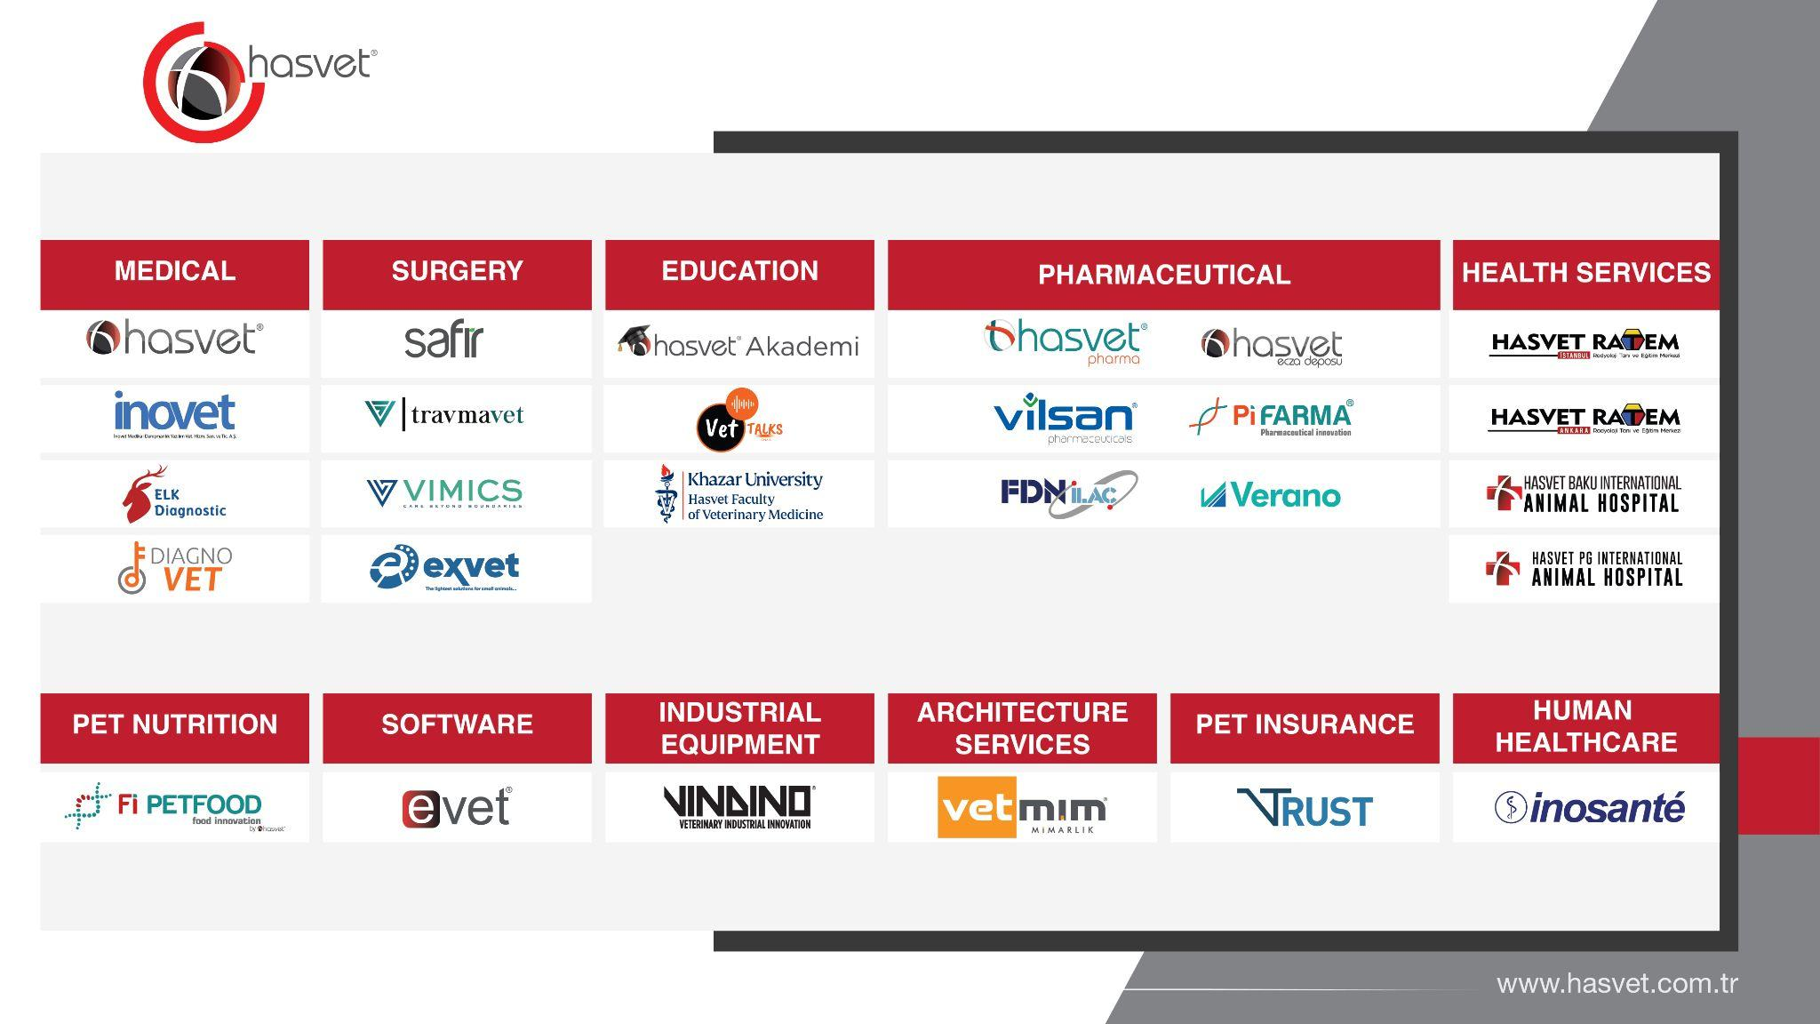

Slide 7
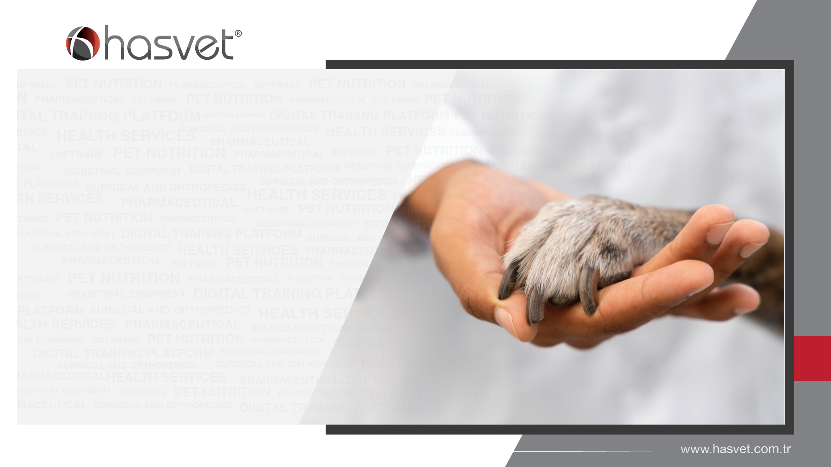
Market Share % 87
Growth 1,4 x
Product 15.000
Customer 13.000
Educatıon 3500
Brand 150
Employee 600
Supplier 180
+
+
+
+

Slide 8
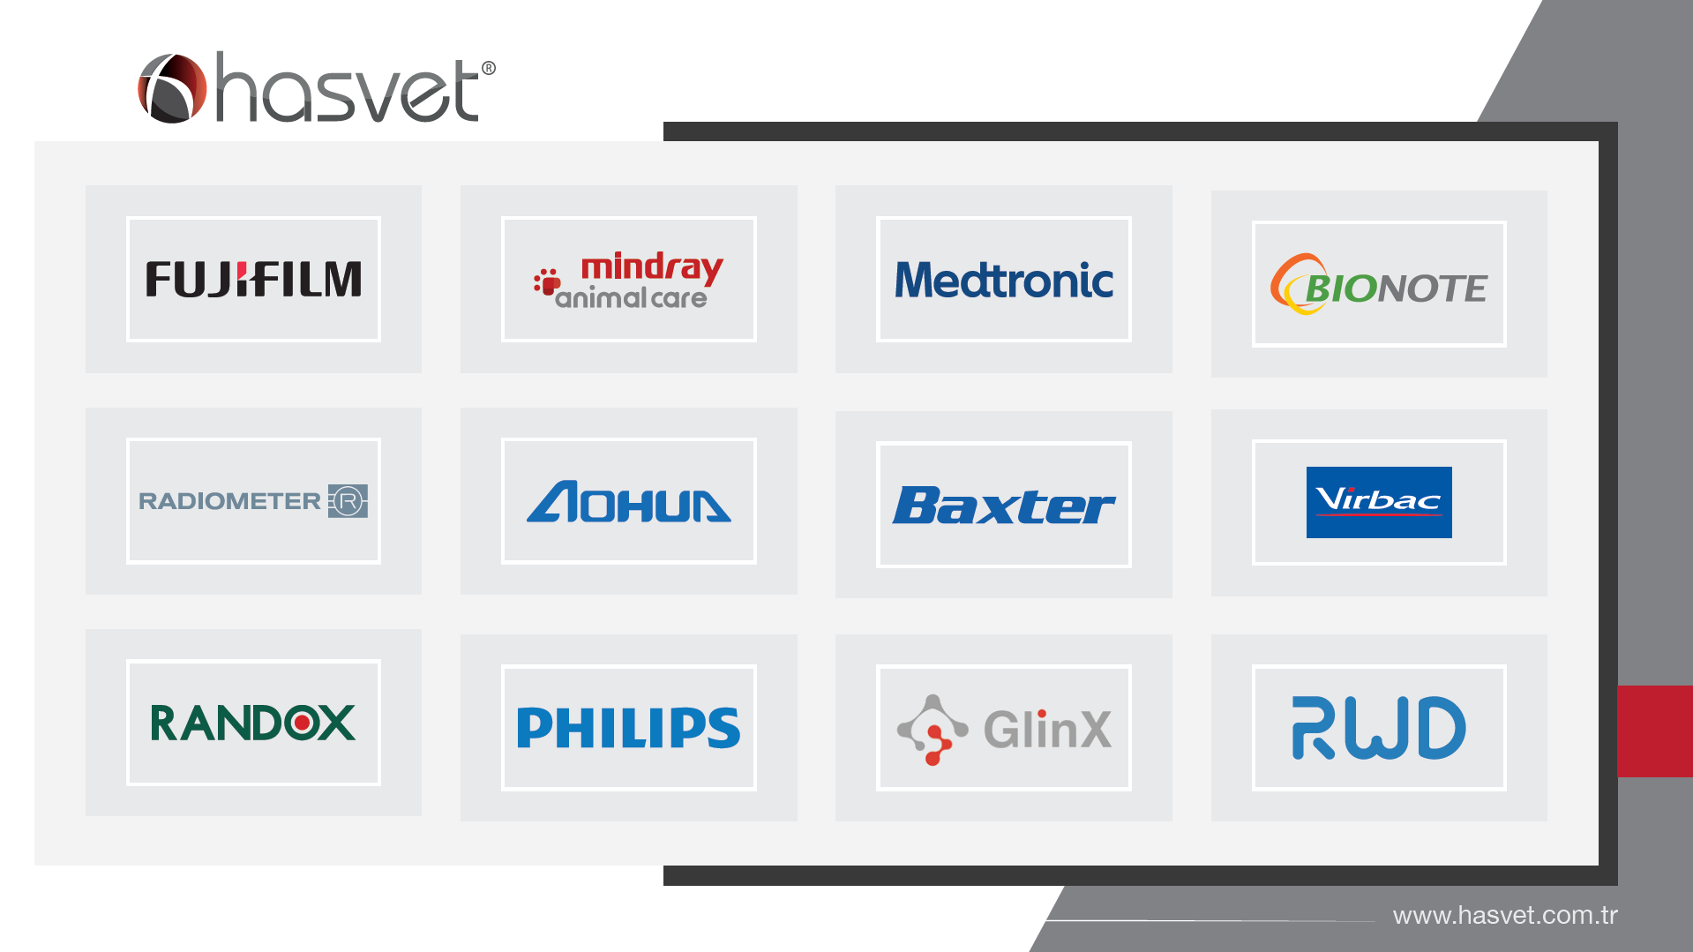

Slide 9
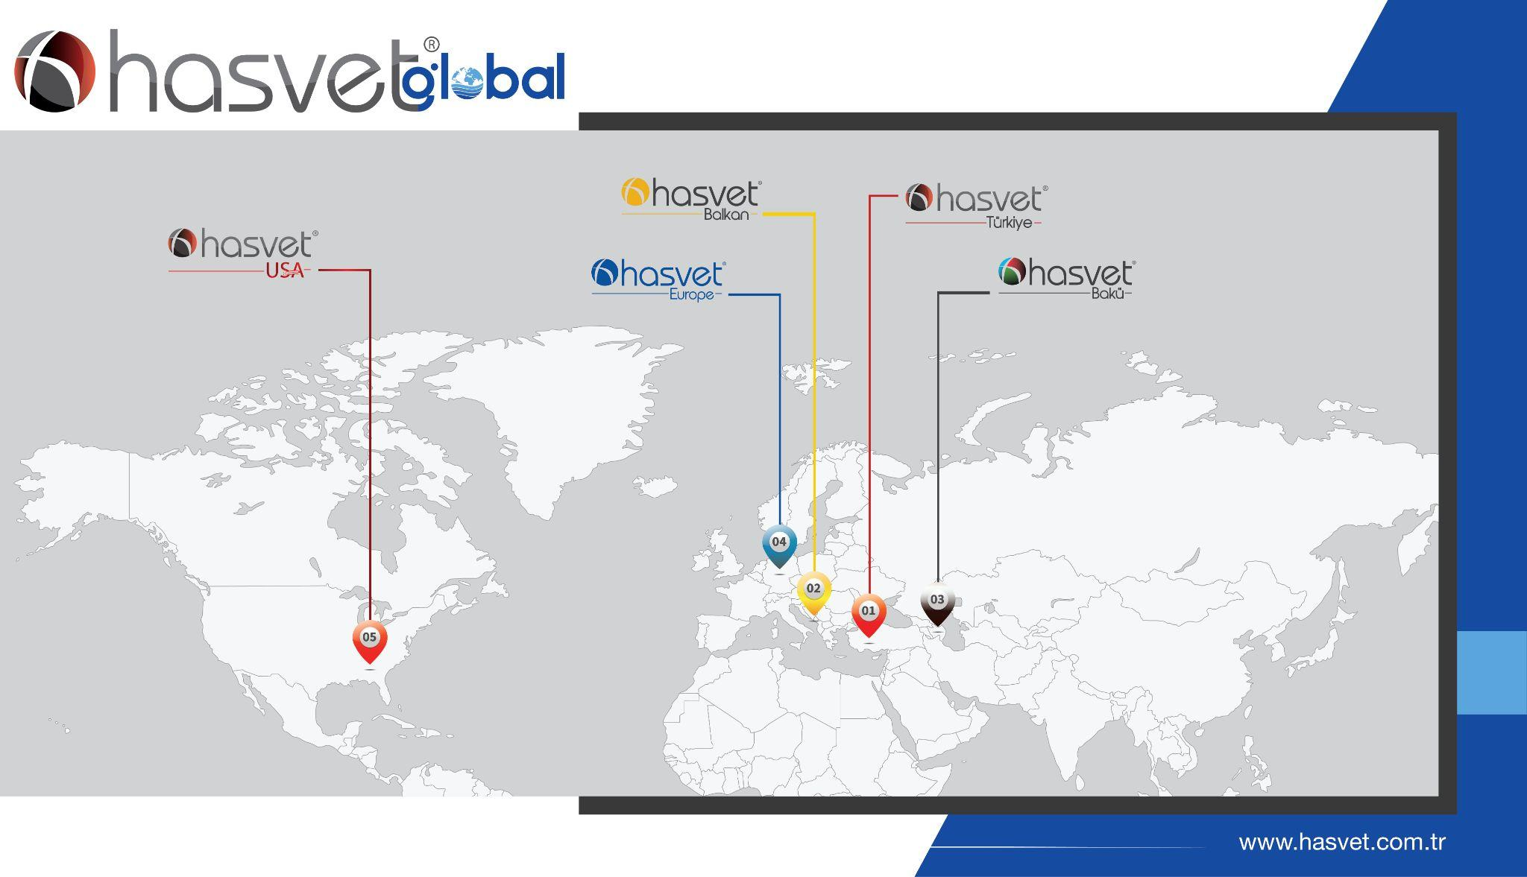

Slide 10
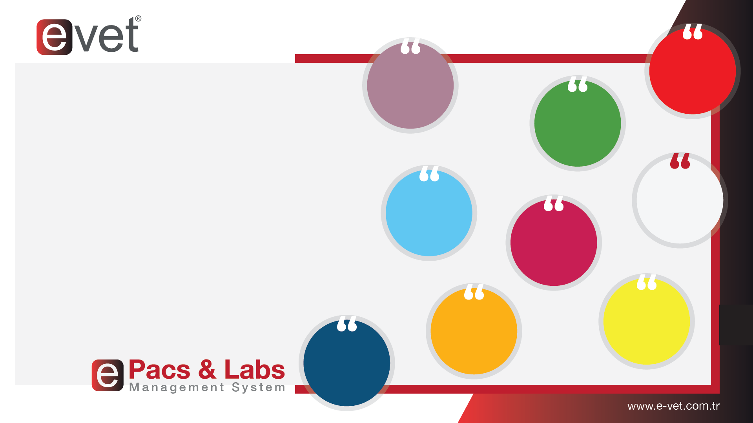
Expert Team of 20 Persons
Patient Follow-up
7/24
Support
E-vet Software Automation System is a program specially developed for hospitals and veterinary clinics.
It ensures that medical, financial and administrative processes are recorded in animal hospitals and that clinic management is carried out professionally.
Online Appointment
Laboratory Management
Administrative Management
Stock Management
25 Separate Modules
Accounting
Finance

Slide 11
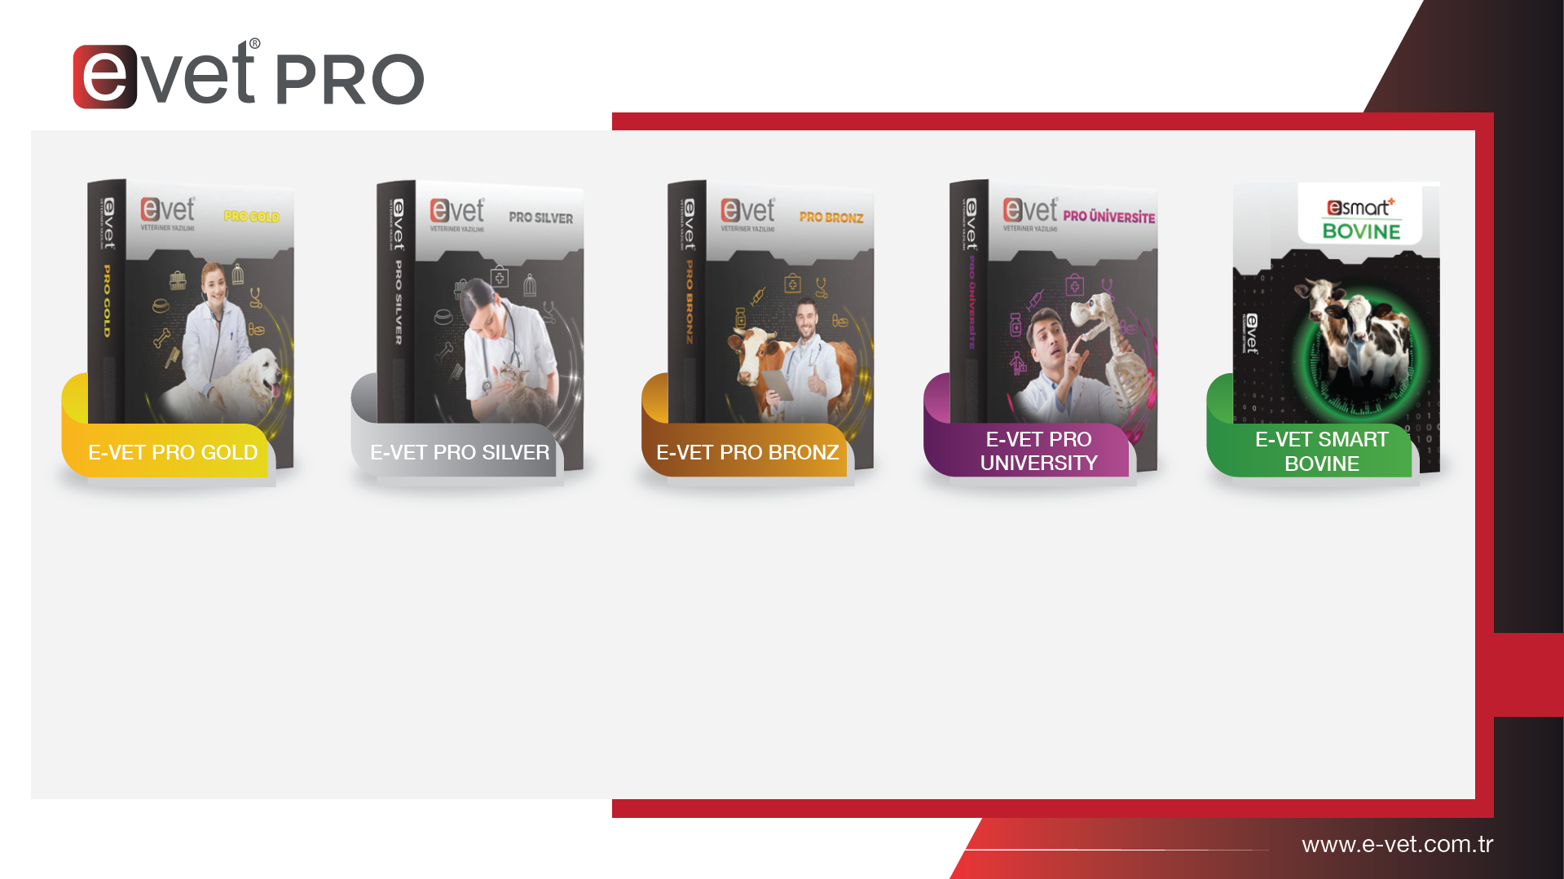
2200+
Clinics and Polyclinics
35+
Animal Hospital
20
Faculty of Veterinary Medicine

Slide 12
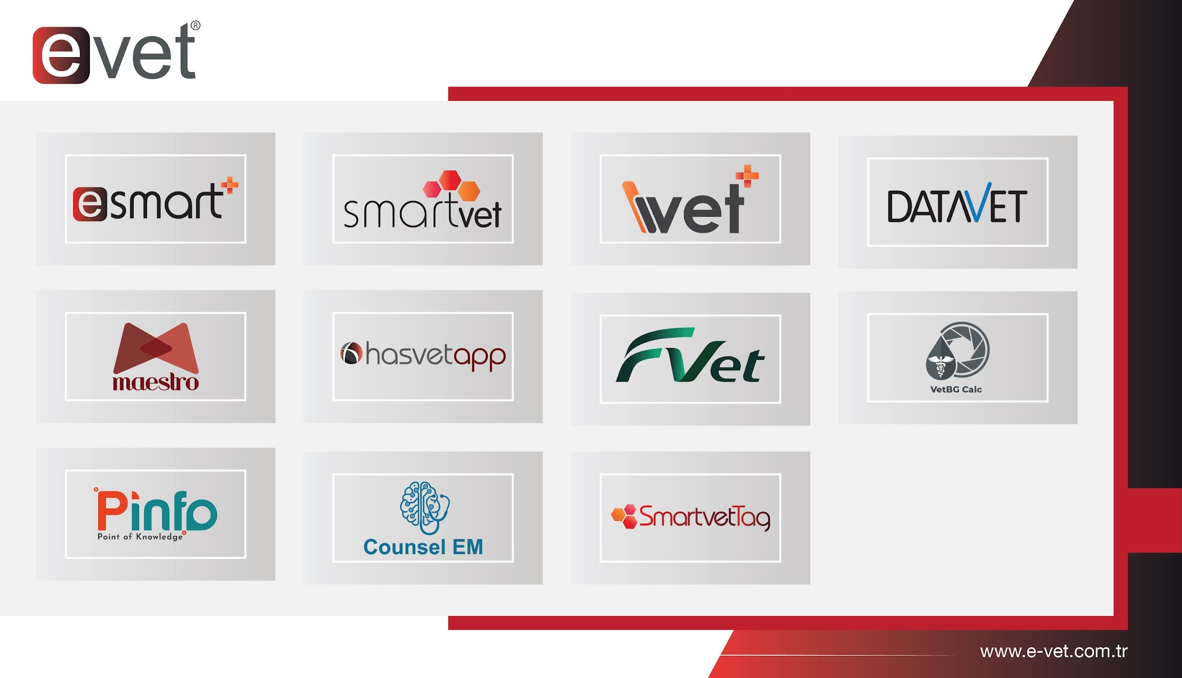

Slide 13
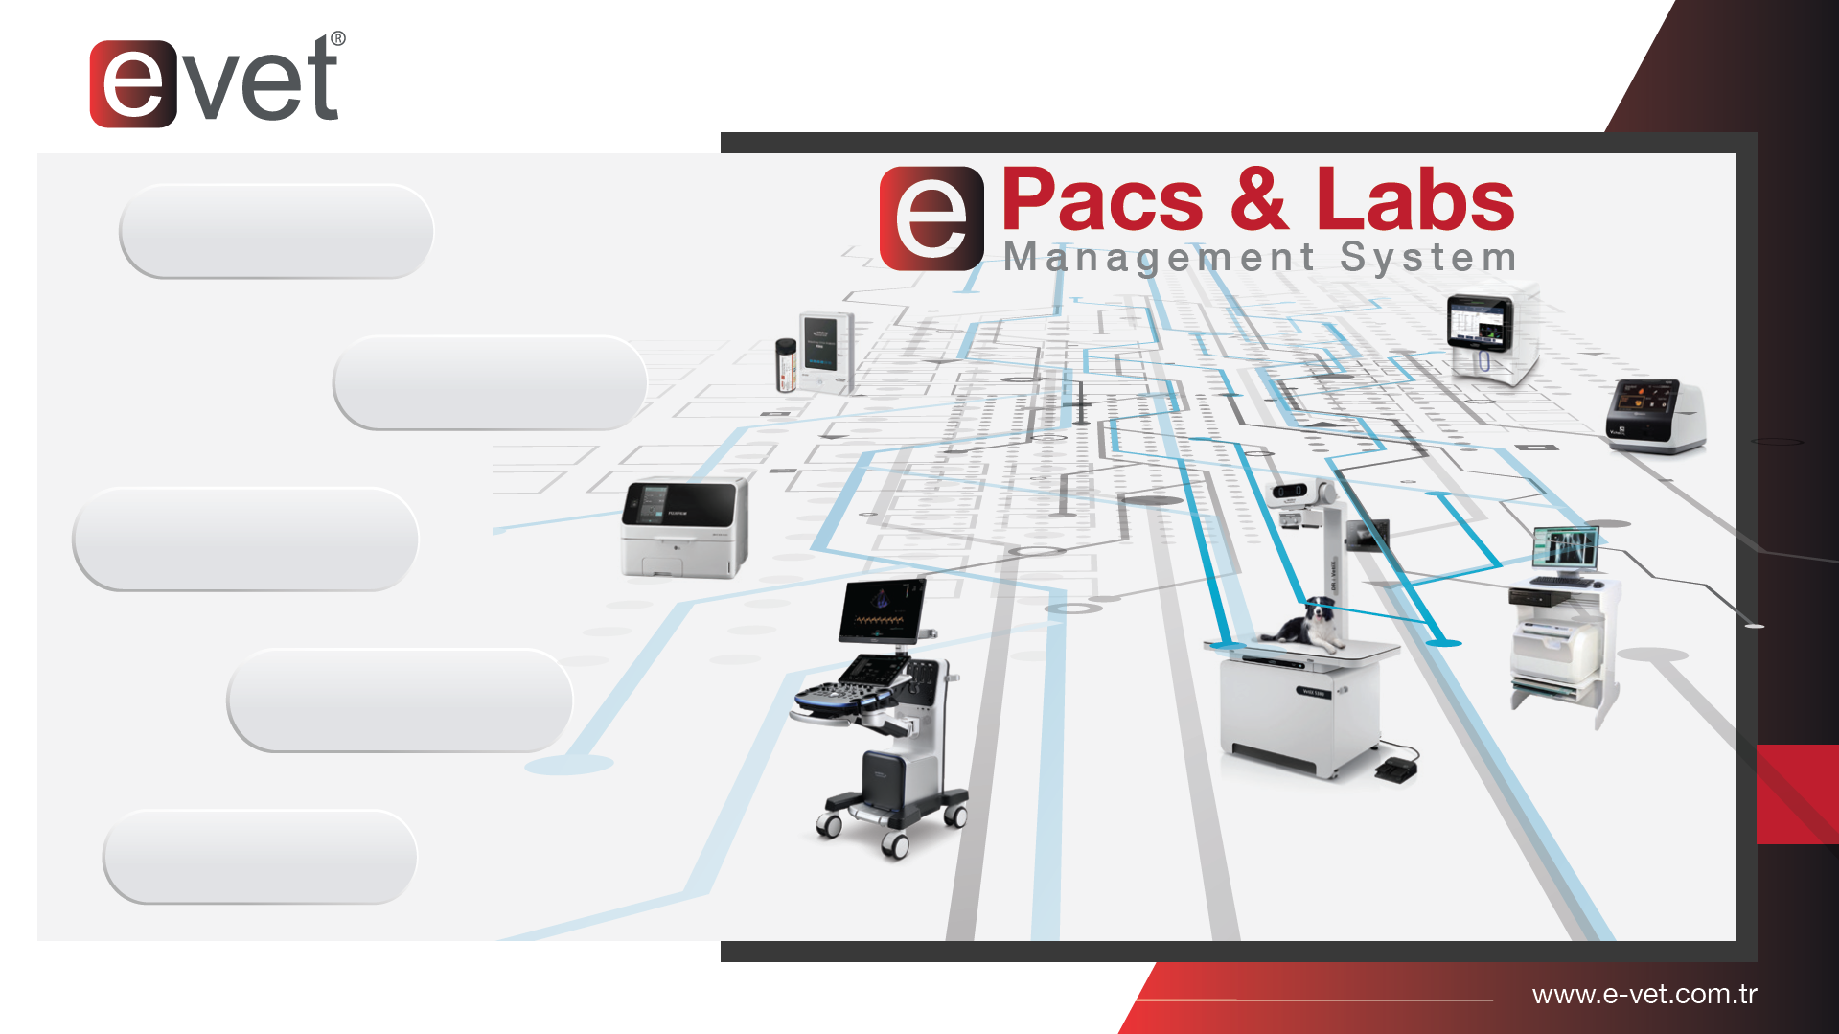
Corporate Memory with Archiving Feature
Saving Time with Mobile Usage
Ease of Diagnosis with Measurement Methods
Comparing Past Results
Advanced Image Processing Technology

Slide 14

‘‘Digital
Health Card
in Mobile’’
All Appointments
Automatic Notification
Labarotory Results and Imaging
Profile and Weight
Clinical Shop
SmartvetTag

Slide 15
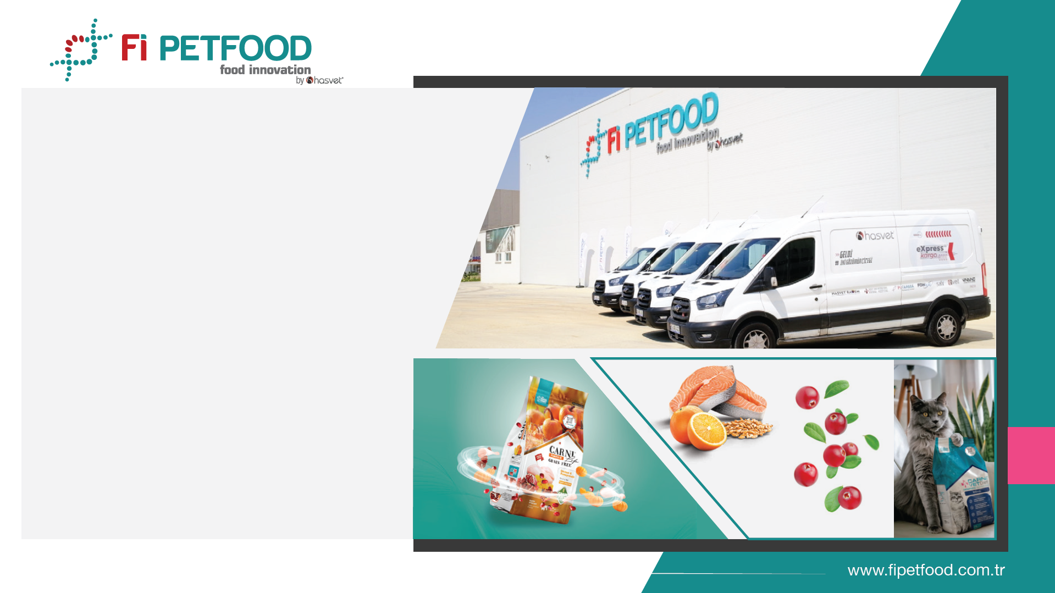
Fi Petfood aims to provide the most natural nutrition for our furry friends by complementing medical treatments in animal health with veterinary diet series foods. Our facility has 11,000 m2 of closed area on 30,000 m2 of land. It operates in the OSB in Kırklareli province.

Slide 16
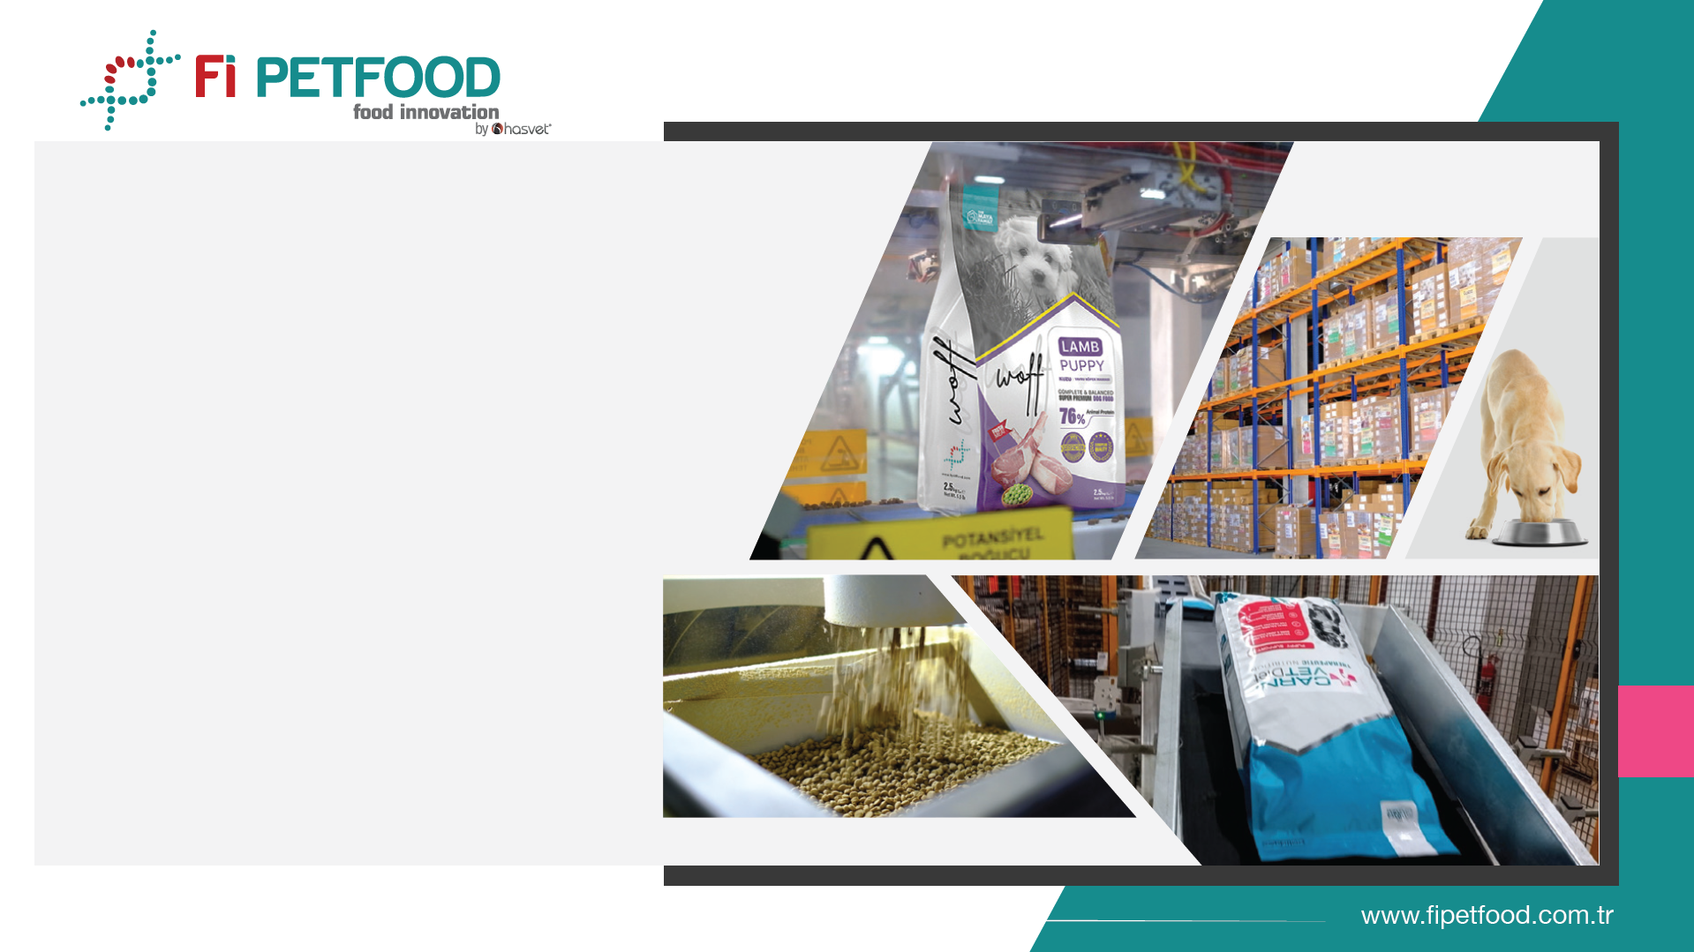
ISO 22000: 2018 Food Safety Management System
ISO 9001: 2015 Quality Management System
ISO 45001 Occupational Health and Safety
Management System
ISO 14001 Environmental Management System
In 2024,
1 Million Kilograms
of food was produced.

Slide 17
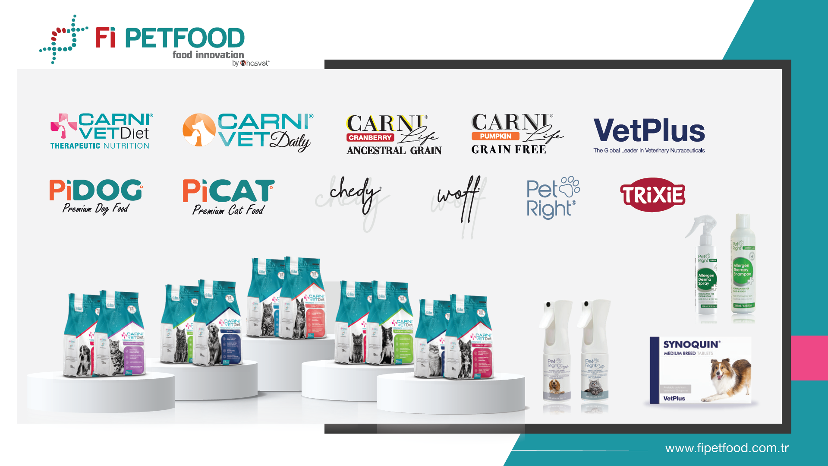
1500+ Veterinary Clinics
300+ Pet Shop

Slide 18
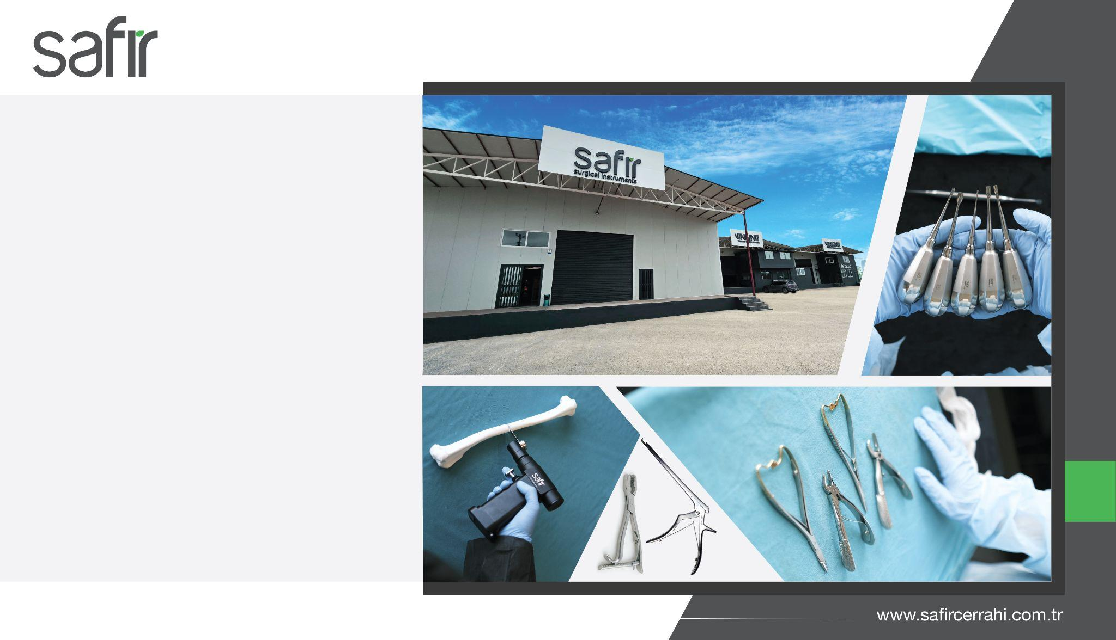
With Safir Surgical Instruments, we provide quality, ergonomics and surgical comfort to the user by processing German-origin raw materials with the latest technology machinery equipment. We manufacture approximately 18,000 different products in the fields of human and veterinary surgery with our professional staff.

Slide 19
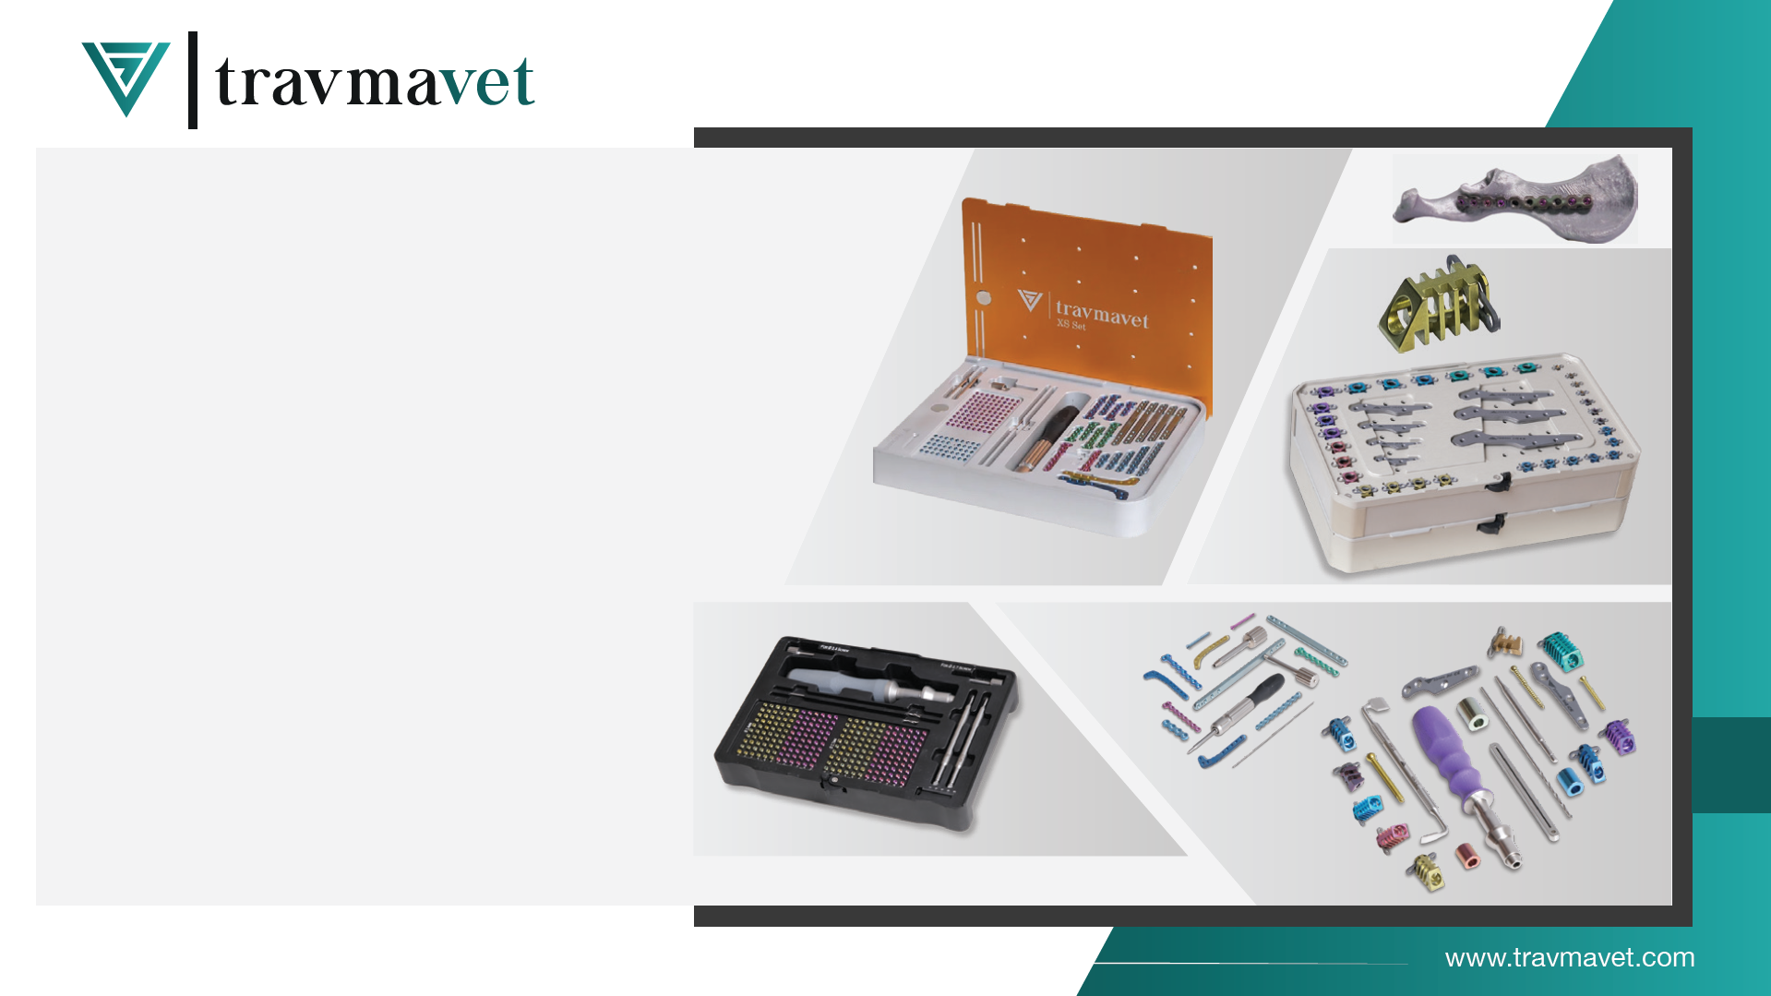
With Travmavet, we offer premium products and services to veterinarians who seek more successful, more up-to-date solutions with quality implants and equipment, and who prefer us over existing alternatives for our innovative and proven designs produced from quality titanium raw material, who value their profession and patients, and who question the best.

Slide 20
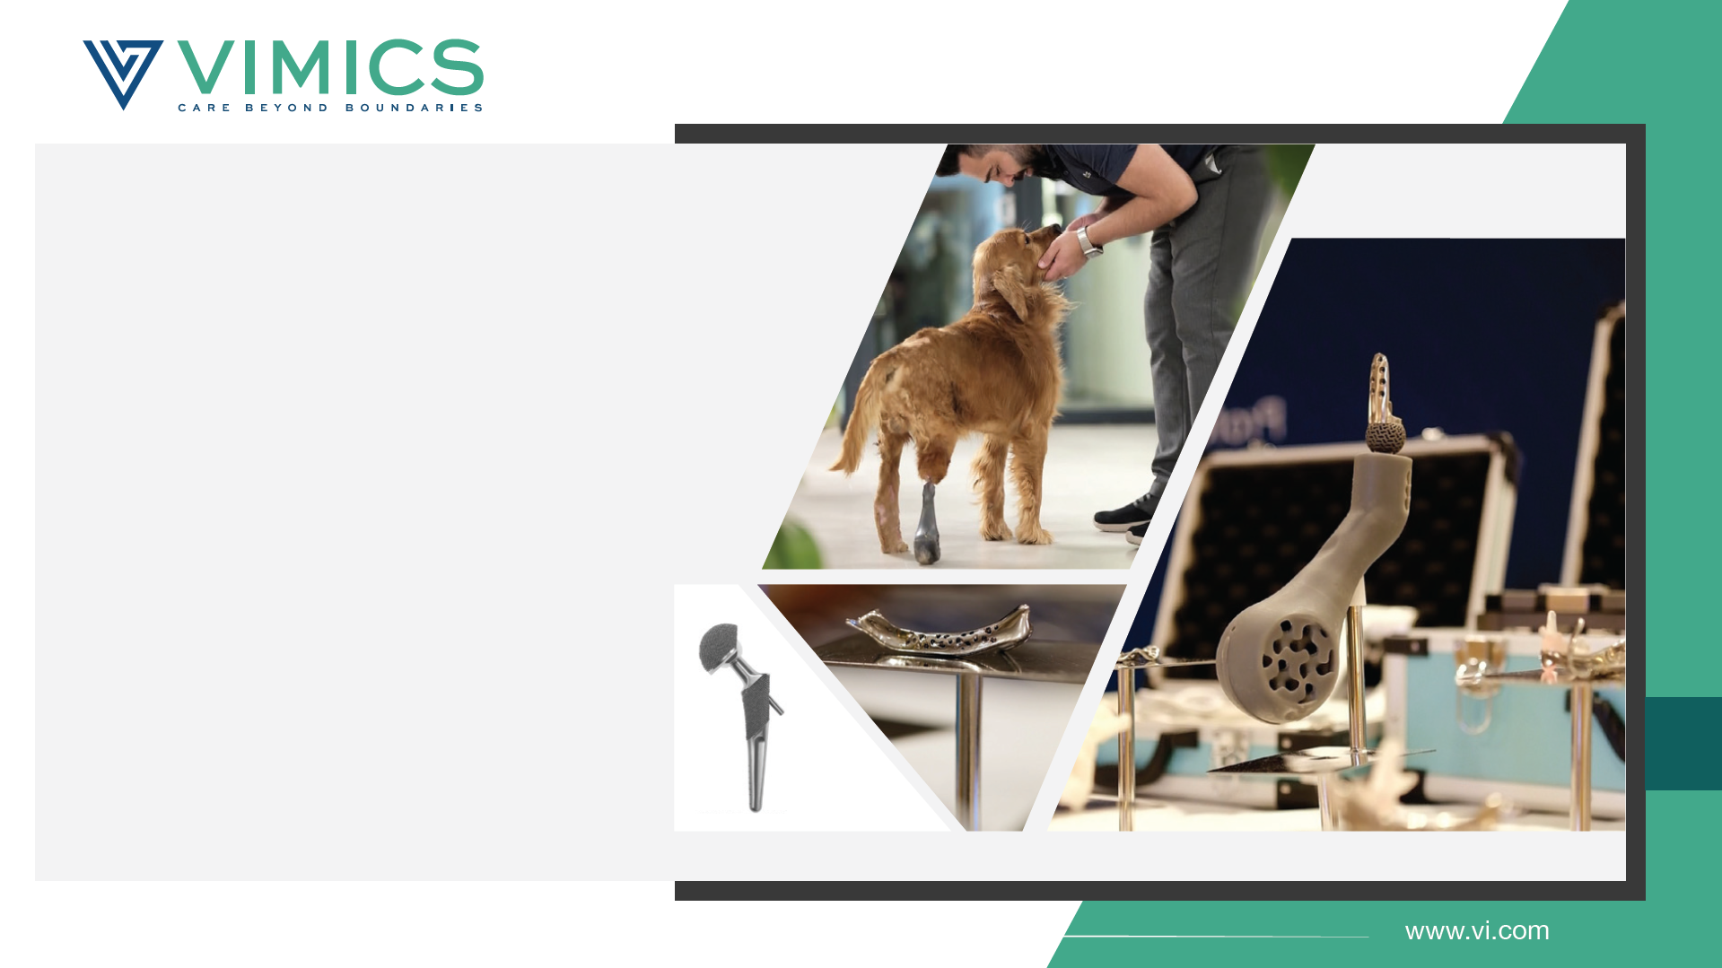
VIMICS is a research and development company dedicated to revolutionizing veterinary medicine through the application of high-tech solutions. Its multidisciplinary team consists of veterinarians, biomedical engineers and mechanical engineers who work collaboratively to address complex cases where standard implant treatments are inadequate.
VIMICS is a leading research and development company offering 3D personalized implants and innovative surgical solutions in veterinary medicine, featuring osseointegrative surfaces that mimic the mechanical properties of natural bone and case-specific designs.

Slide 21
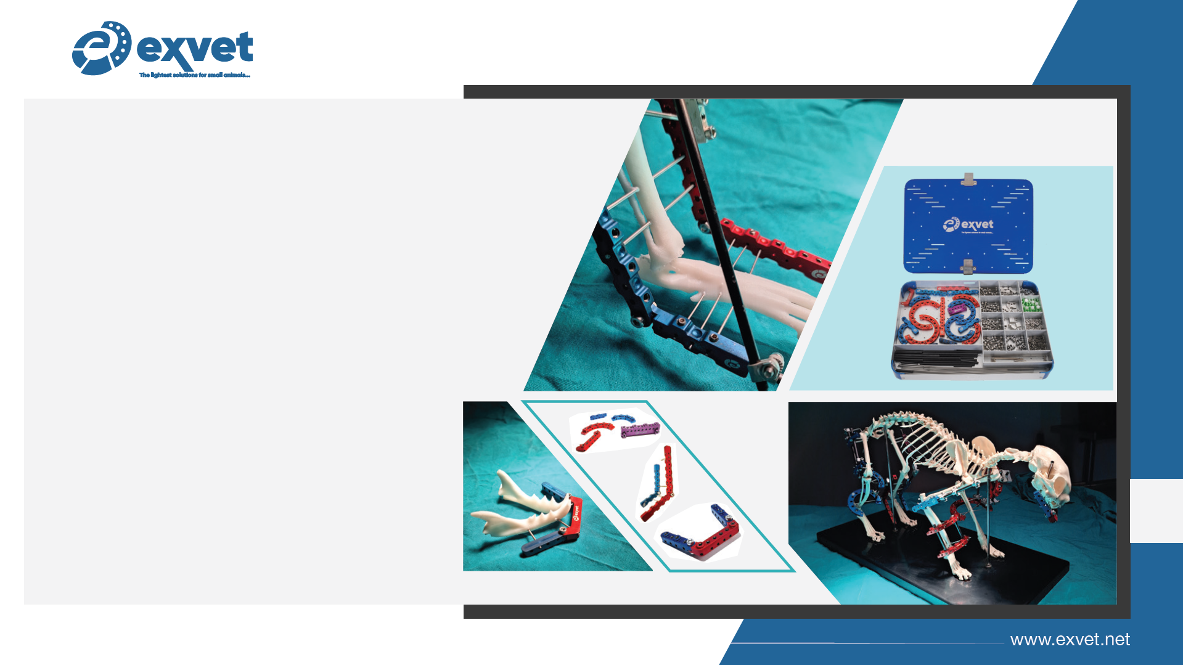
ExVet was founded in 2021 at Ankara University Technopark with the support of TÜBİTAK 1512, specializing in innovative external fixators for veterinary orthopedics. The Small series is designed for cats and dogs under 12 kg, offering lightweight and reusable external fixation sets. Available in Basic, Advanced, and Professional sets, these solutions provide scalable options based on surgical needs.

Slide 22
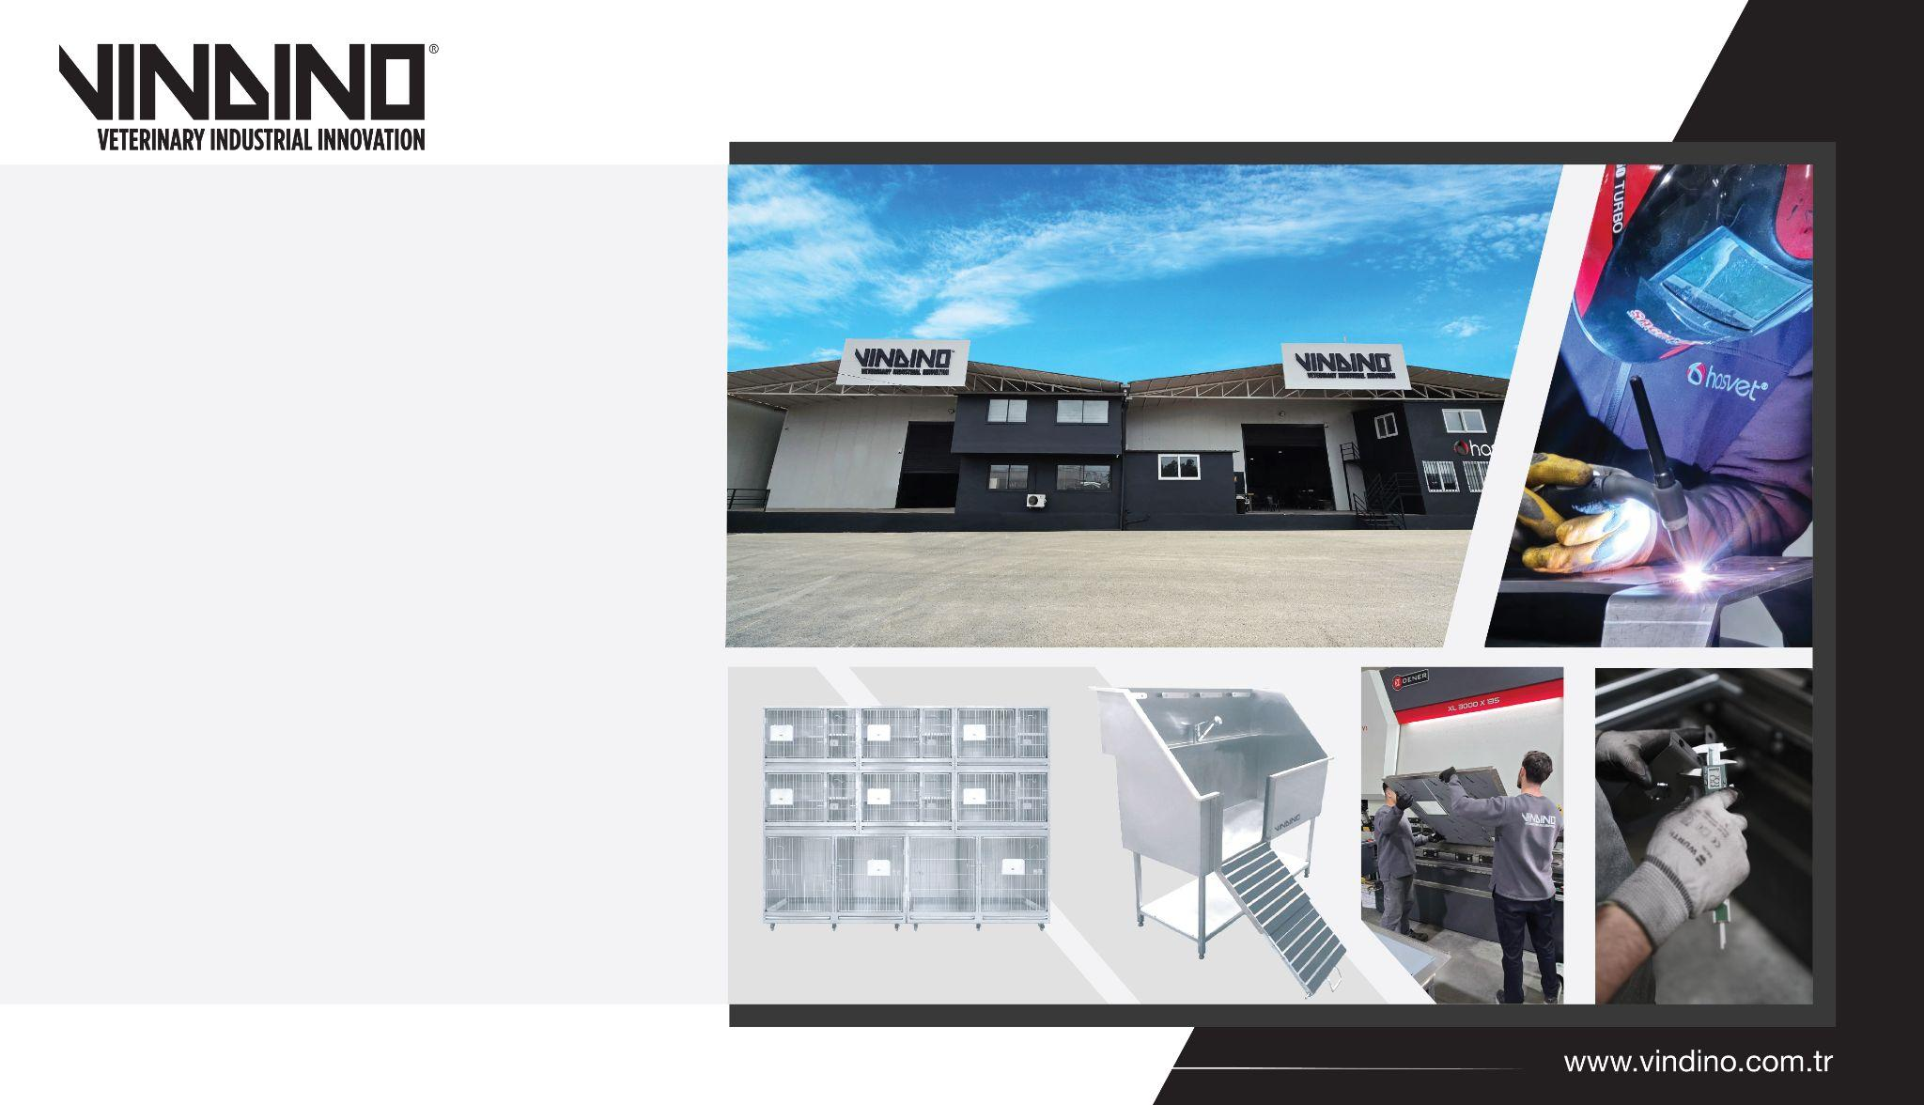
With the VINDINO brand, we manufacture innovative products using 304 stainless steel in our Antalya production facility, which has the infrastructure to meet the needs worldwide, such as cages, automatic operation tables, examination tables, pre-operation preparation units, pet shaving and washing units, device stands and trolleys, automatic floating x-ray tables, which are needed by all clinics and hospitals.

Slide 23
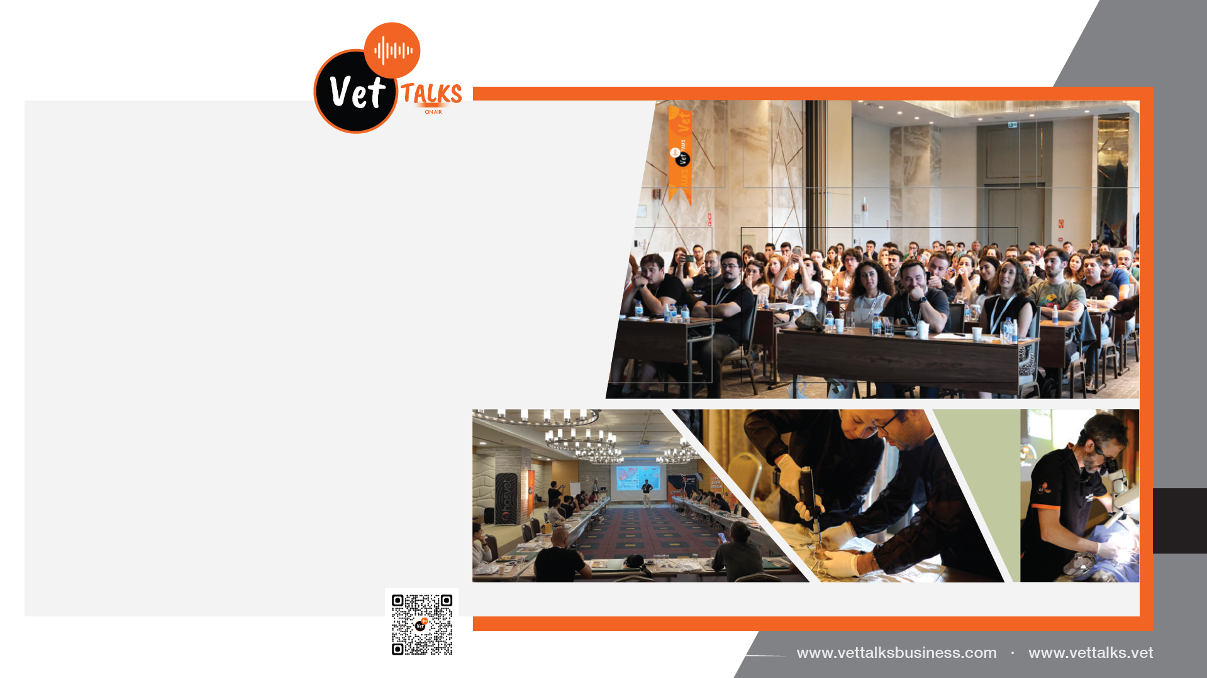
"Vettalks Business" within the Vettalks group of companies serves the needs by incorporating all the organization and congress solutions that the sector needs. On this path that we started with the motto "THE FUTURE OF INNOVATION"; we act with the vision that the future of the developing and changing World is based on informatics and all formations with informatics infrastructure.

Slide 24
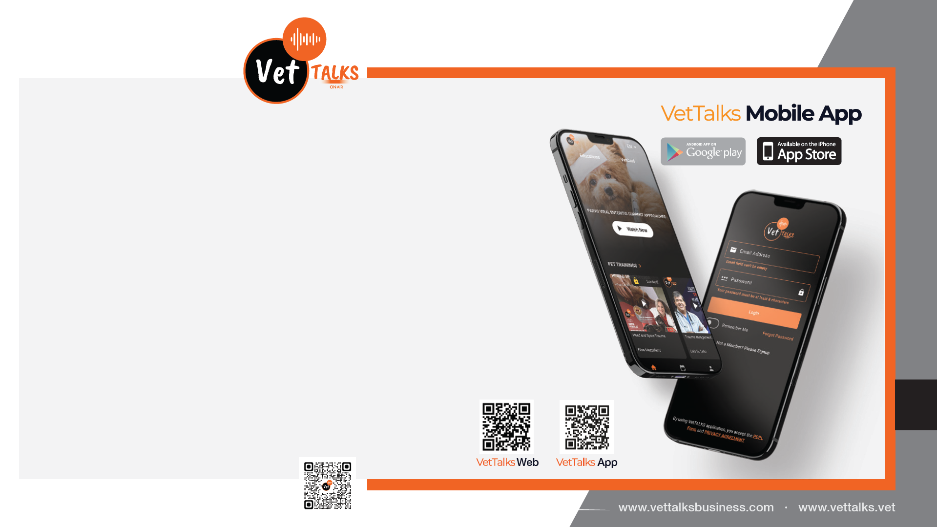
NEW GENERATION!
EDUCATION AND COMMUNICATION PLATFORM
Vettalks is a platform that includes 10,000 veterinarians and veterinary candidates. The trainings of important trainers in the world and in Turkey are constantly uploaded to the platform. Thus, the most accurate and up-to-date information, training can be accessed in the fastest and most innovative way.

Slide 25
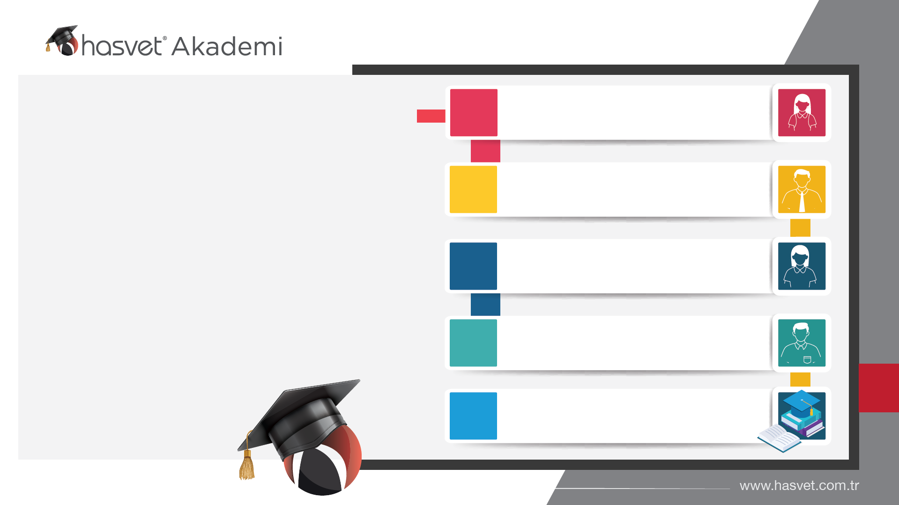
Congress and Symposium
350
With the Hasvet Academy team, which is the most valuable part of our patient-focused ecosystem and consists of 11 experts in their fields and also includes academics, we add value to all our colleagues and the profession by regularly providing professional training in a multidisciplinary structure that is unique in the sector.
Online Education
2200
Applied Training
520
Distance Education and Support
300
4
Hasvet Academy Book

Slide 26

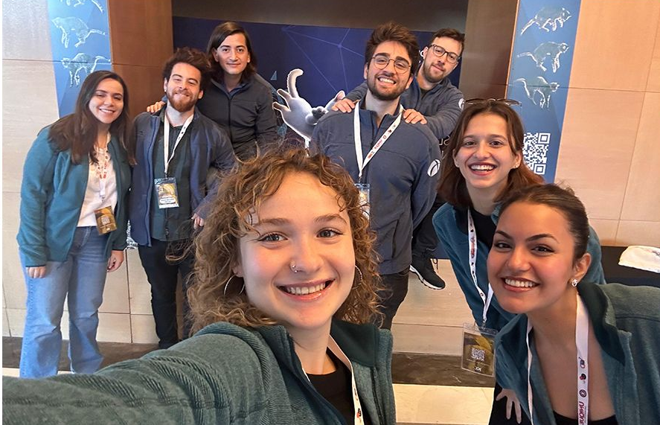
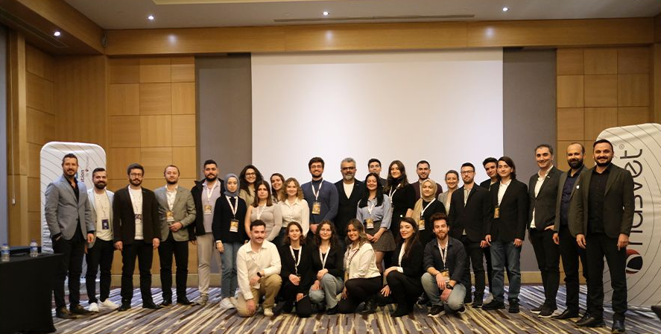
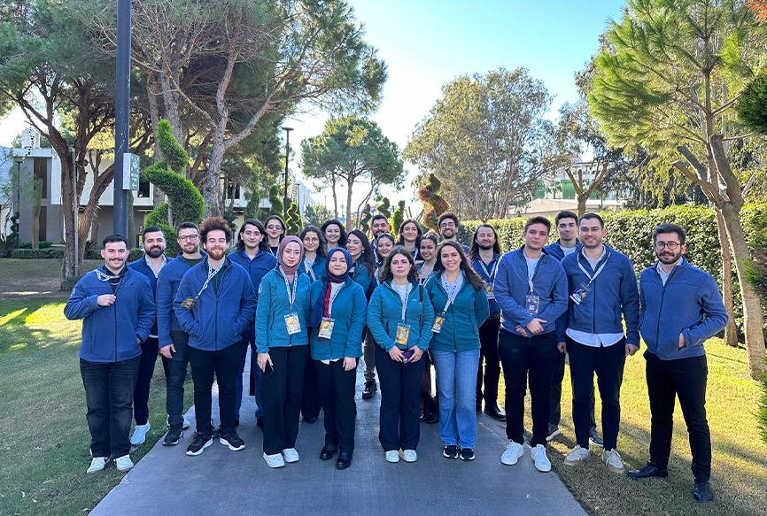
Student Counsil
Hasvet Student Council, which we established in 2014, is an organization made up of students from all veterinary faculties throughout the country.
The student council aims to direct students' education and business lives with the vision of Hasvet.
Many of our friends, who have been in our student council until today, have succeeded in being the leaders of the sector in its different fields. In addition, the 3 of our friends who took part in our student council are currently working in the managerial positions in our company.

Slide 27
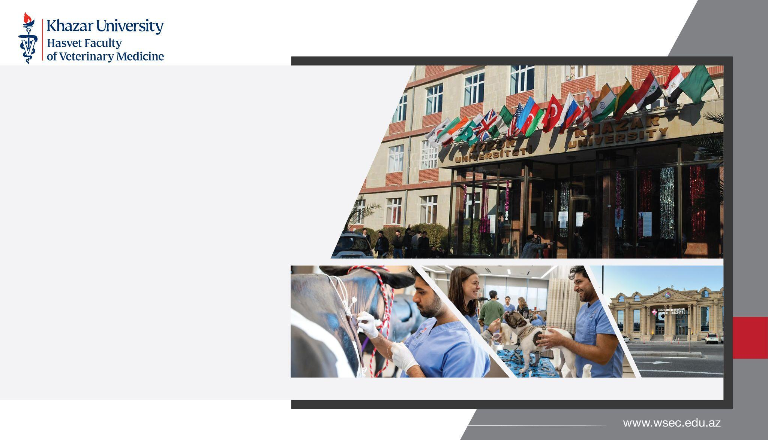
Hasvet Inc. is establishing a world-class Veterinary Faculty within Khazar University in order to shape the future of veterinary medicine.
This faculty, which will be equipped with state-of-the-art devices, aims to train graduates who are competent and equipped in their profession by providing students with the opportunity to reinforce theoretical knowledge with practical applications. This faculty, which will be built with Hasvet's expertise and innovative approach, will take quality and sustainable education in the veterinary field to a new level.

Slide 28
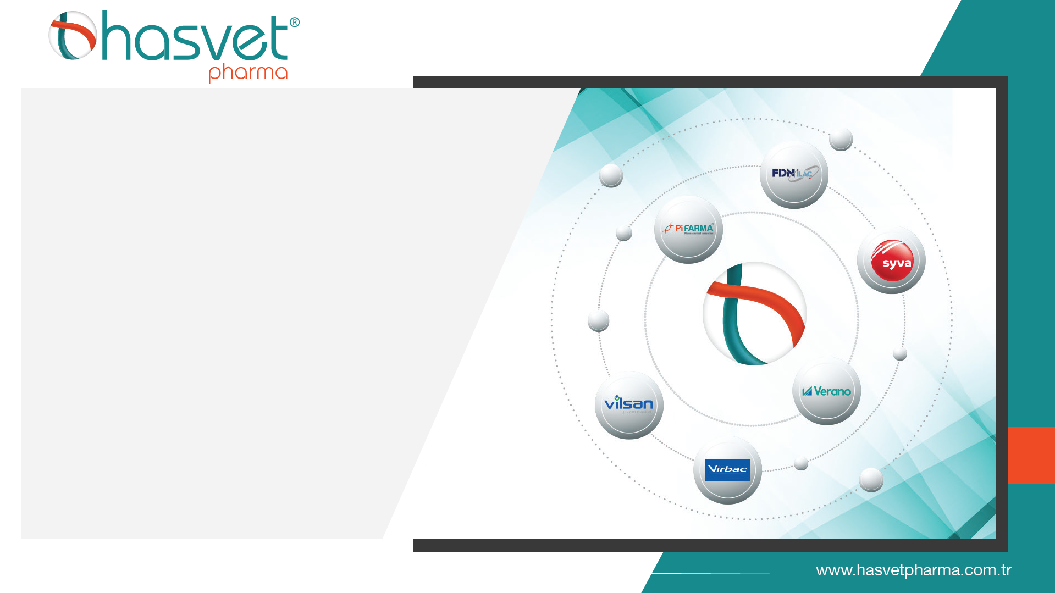
Hasvet Pharma is the largest pharmaceutical group in Turkey, MENA Region, Balkan Countries and Turkic Republics in animal health pharmaceutical production with the Pi Farma, Verano, FDN İlaç and Vilsan brands it has established locally and the Virbac and Syva pharmaceutical distributorships globally. Hasvet Pharma, which manufactures pharmaceuticals for global animal health brands such as Elanco and Virbac and many companies locally, aims to contribute to a more sustainable animal husbandry policy by reducing Turkey's external dependency in pharmaceutical production.

Slide 29
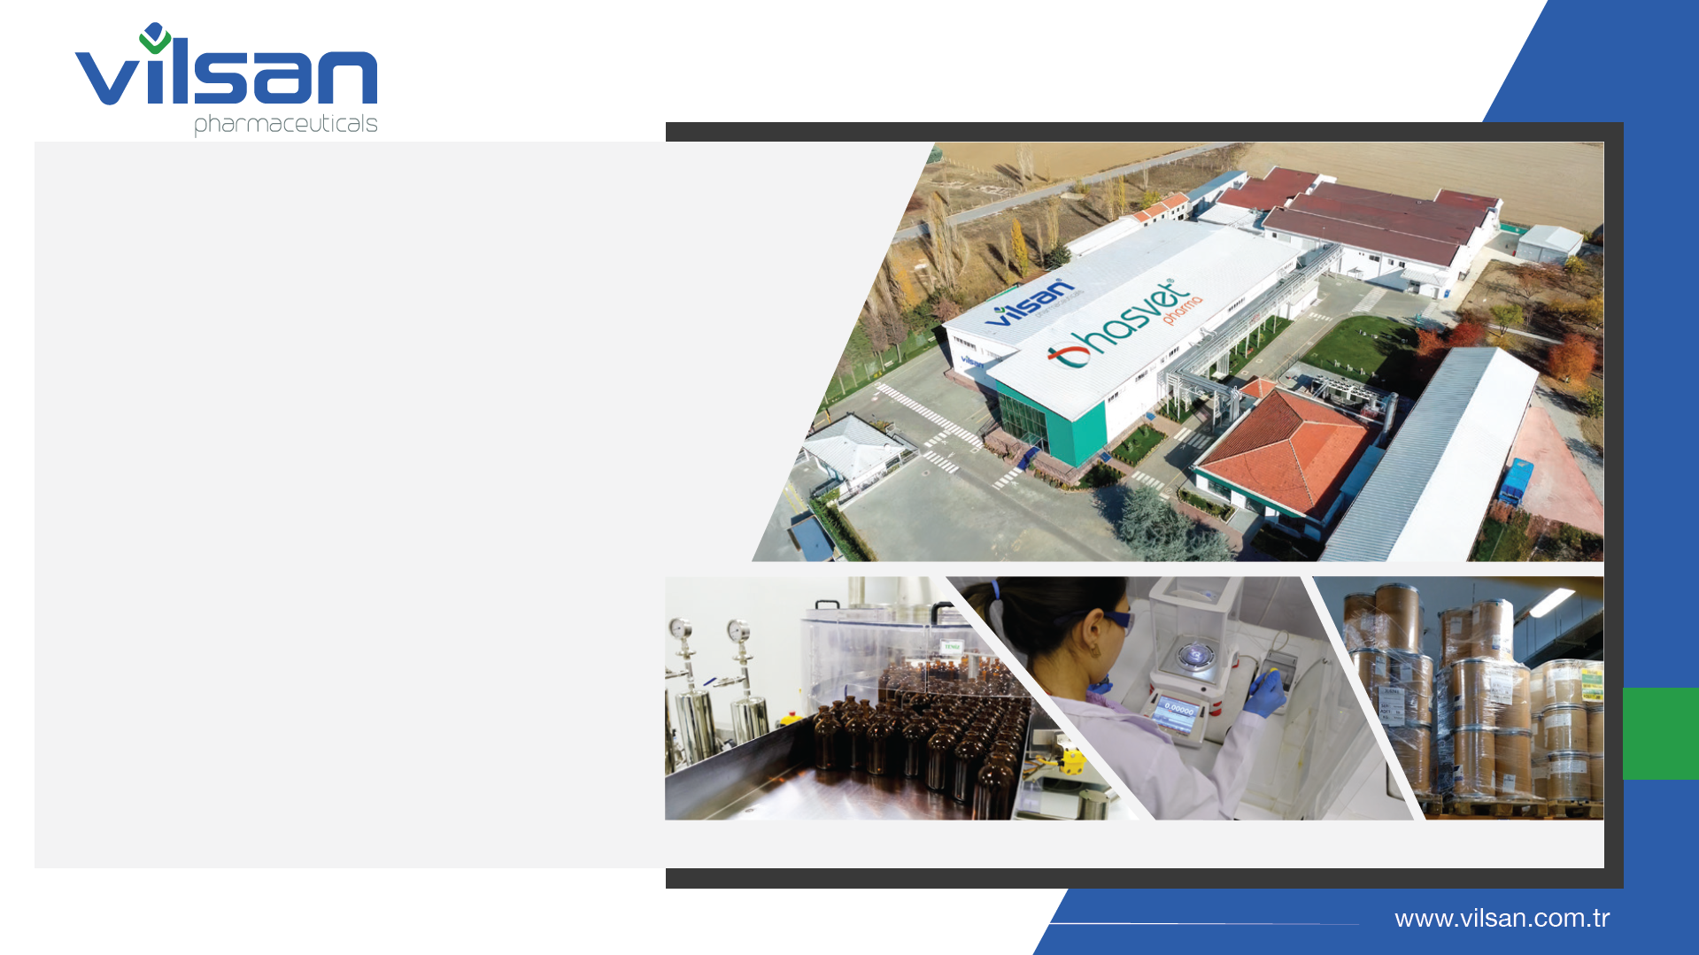
Vilsan has a closed area of ​​10,700 m² built on a 13,500 m² land and is one of the important production facilities of Turkey with its GMP certified modern production lines and technology. It has an annual production capacity of approximately 90 million boxes. It exports to more than 20 countries. Its production lines include Sterile (NBL + BL) solution, emulsion and IMM, Non-Sterile oral solution, oral powder (NBL + BL), tablet and Ectoparasite lines.
9 Production Lines
Sterile - Non-Sterile (Ecto, Powder/Liquid)
RUMINANT PRODUCTS
POULTRY PRODUCTS
AQUA PRODUCTS
62 Licensed Products

Slide 30
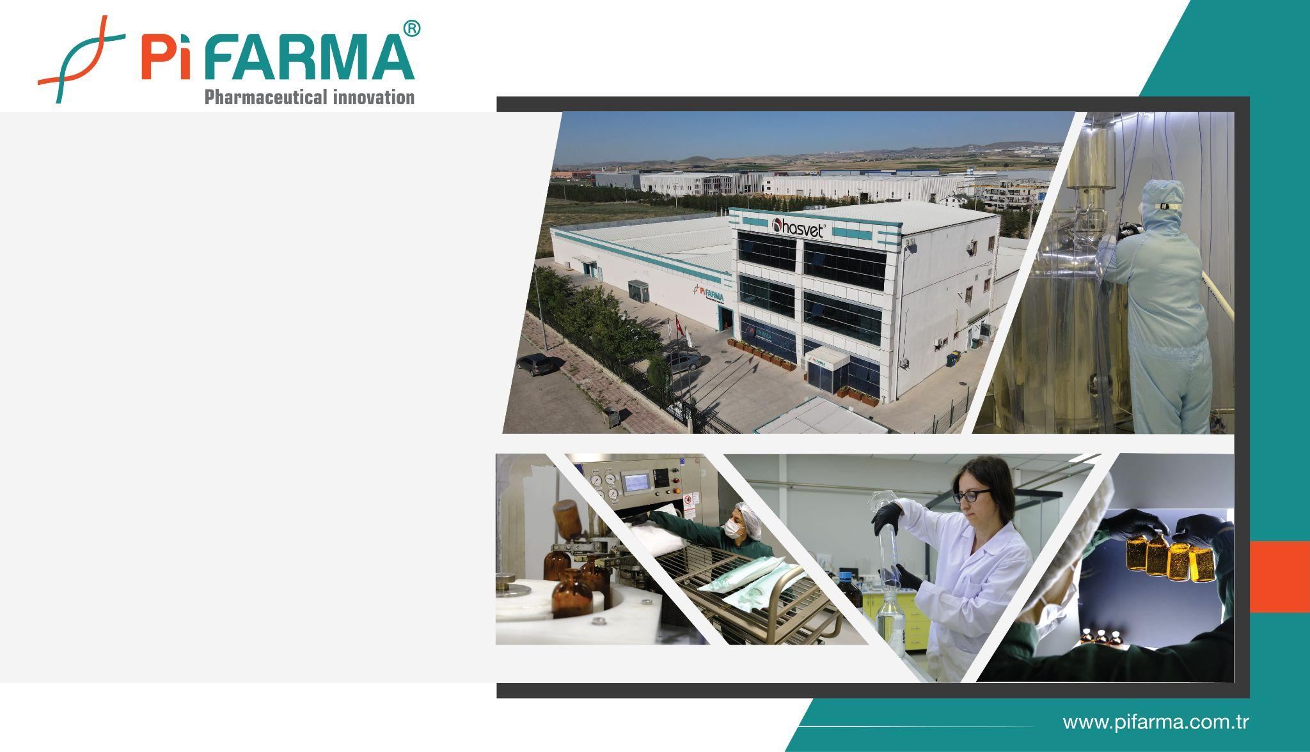
Pi Farma, established on a 7,200 m² land with a 3,800 m² production area, is one of the few production facilities in Turkey with its GMP certified advanced production lines and production technology. It has an annual production capacity of approximately 6 million boxes. Its production lines include Sterile Non-Beta-Lactam, Complementary feed and Ectoparasite lines.
3 Production Lines
Sterile & Non-Sterile & Premix
RUMINANT PRODUCTS
29 Licensed Products
Pi Farma, established on a 7,200 m² land with a 3,800 m² production area, is one of the few production facilities in Turkey with its GMP certified advanced production lines and production technology. It has an annual production capacity of approximately 6 million boxes. Its production lines include Sterile Non-Beta-Lactam, Complementary feed and Ectoparasite lines.
3 Production Lines
Sterile & Non-Sterile & Premix
RUMINANT PRODUCTS
29 Licensed Products

Slide 31
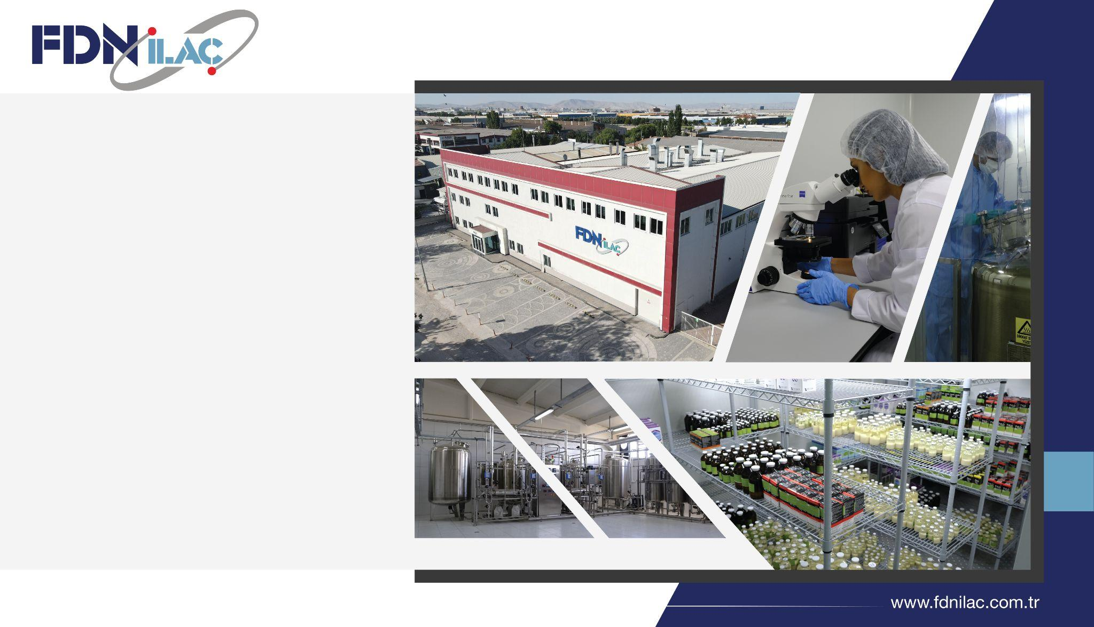
FDN Pharmaceutical, established on a 7,000 m² land with a 6,000 m² production area, is one of the few production facilities in Turkey with its GMP certified advanced production lines and production technology. It has an annual production capacity of approximately 17 million boxes. Its production lines include Beta-Lactam, Non-Beta-Lactam and hormone lines.
3 Production Lines
Non Betalactam & Betalactam
& Hormone
RUMINANT PRODUCTS
Contract Manufacturing

Slide 32
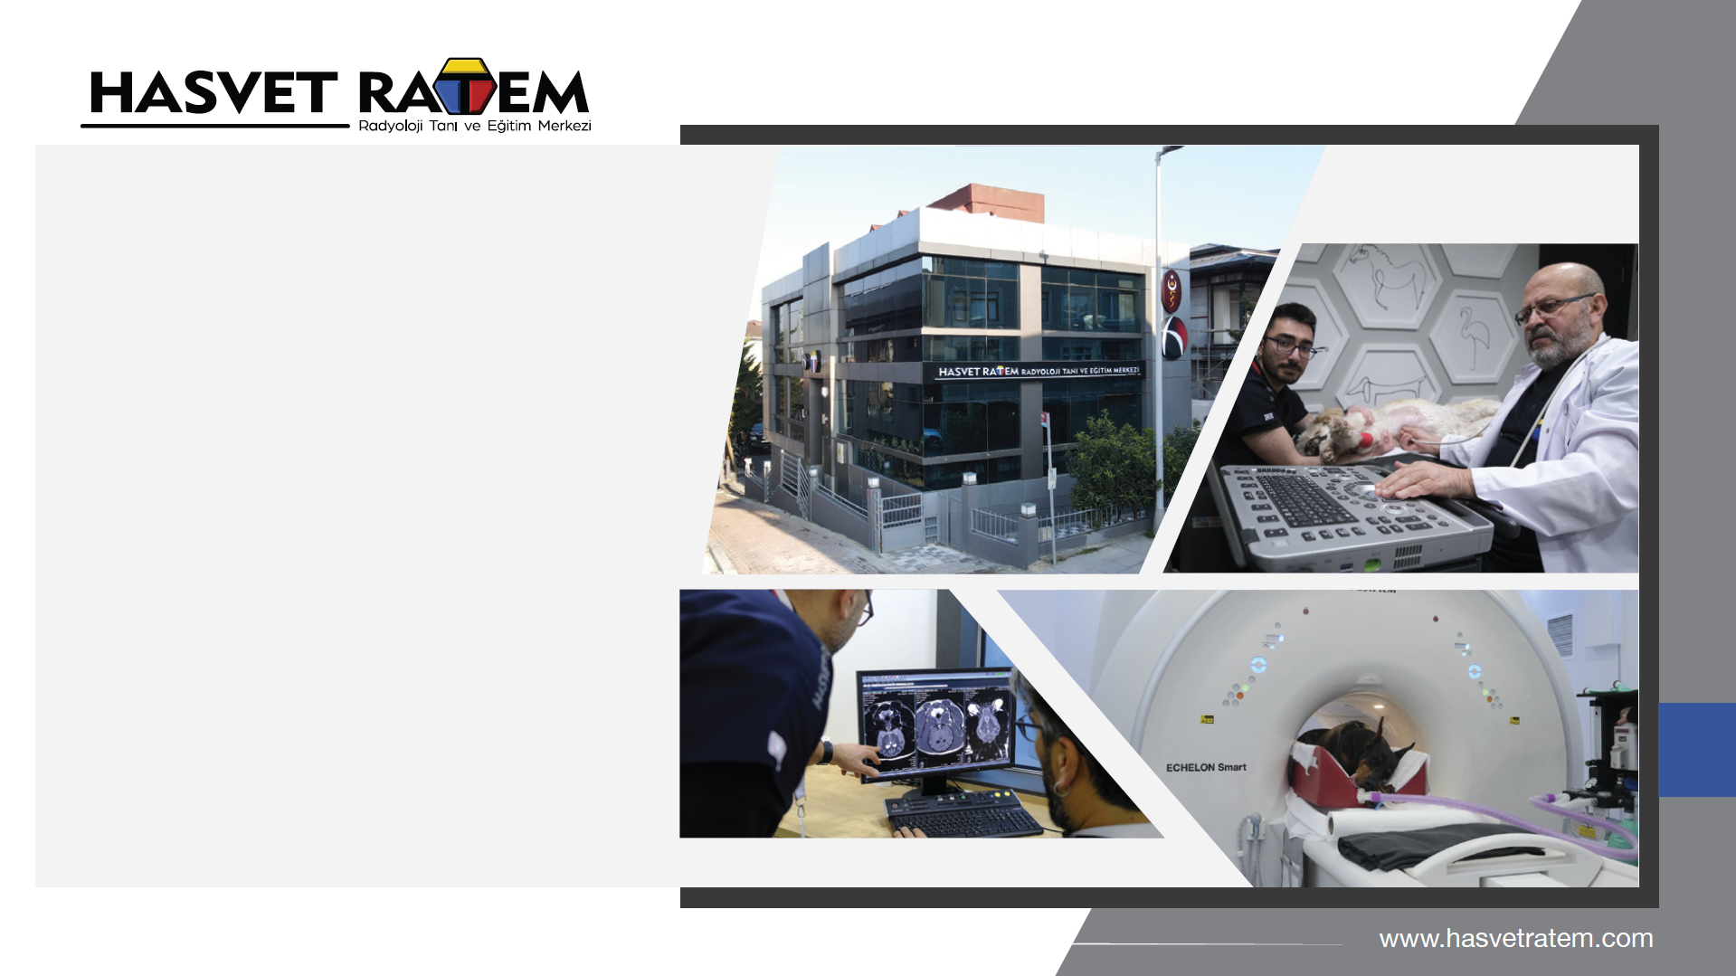

Our centre, which offers solutions to patients referred only from veterinary clinics, using advanced technology and specialist doctors, and organises advanced, practical training courses with experts from Turkey and abroad, includes:
Special Operating Room and Training Areas
MRI Imaging
Computed Tomography
Doppler Ultrasonography
Haemodiafiltration
Lithotripsy
Anaesthesiology
Radiography
Endoscopy
EEG
EMG
Laboratory
Pathology Laboratory
and many other areas.

Slide 33
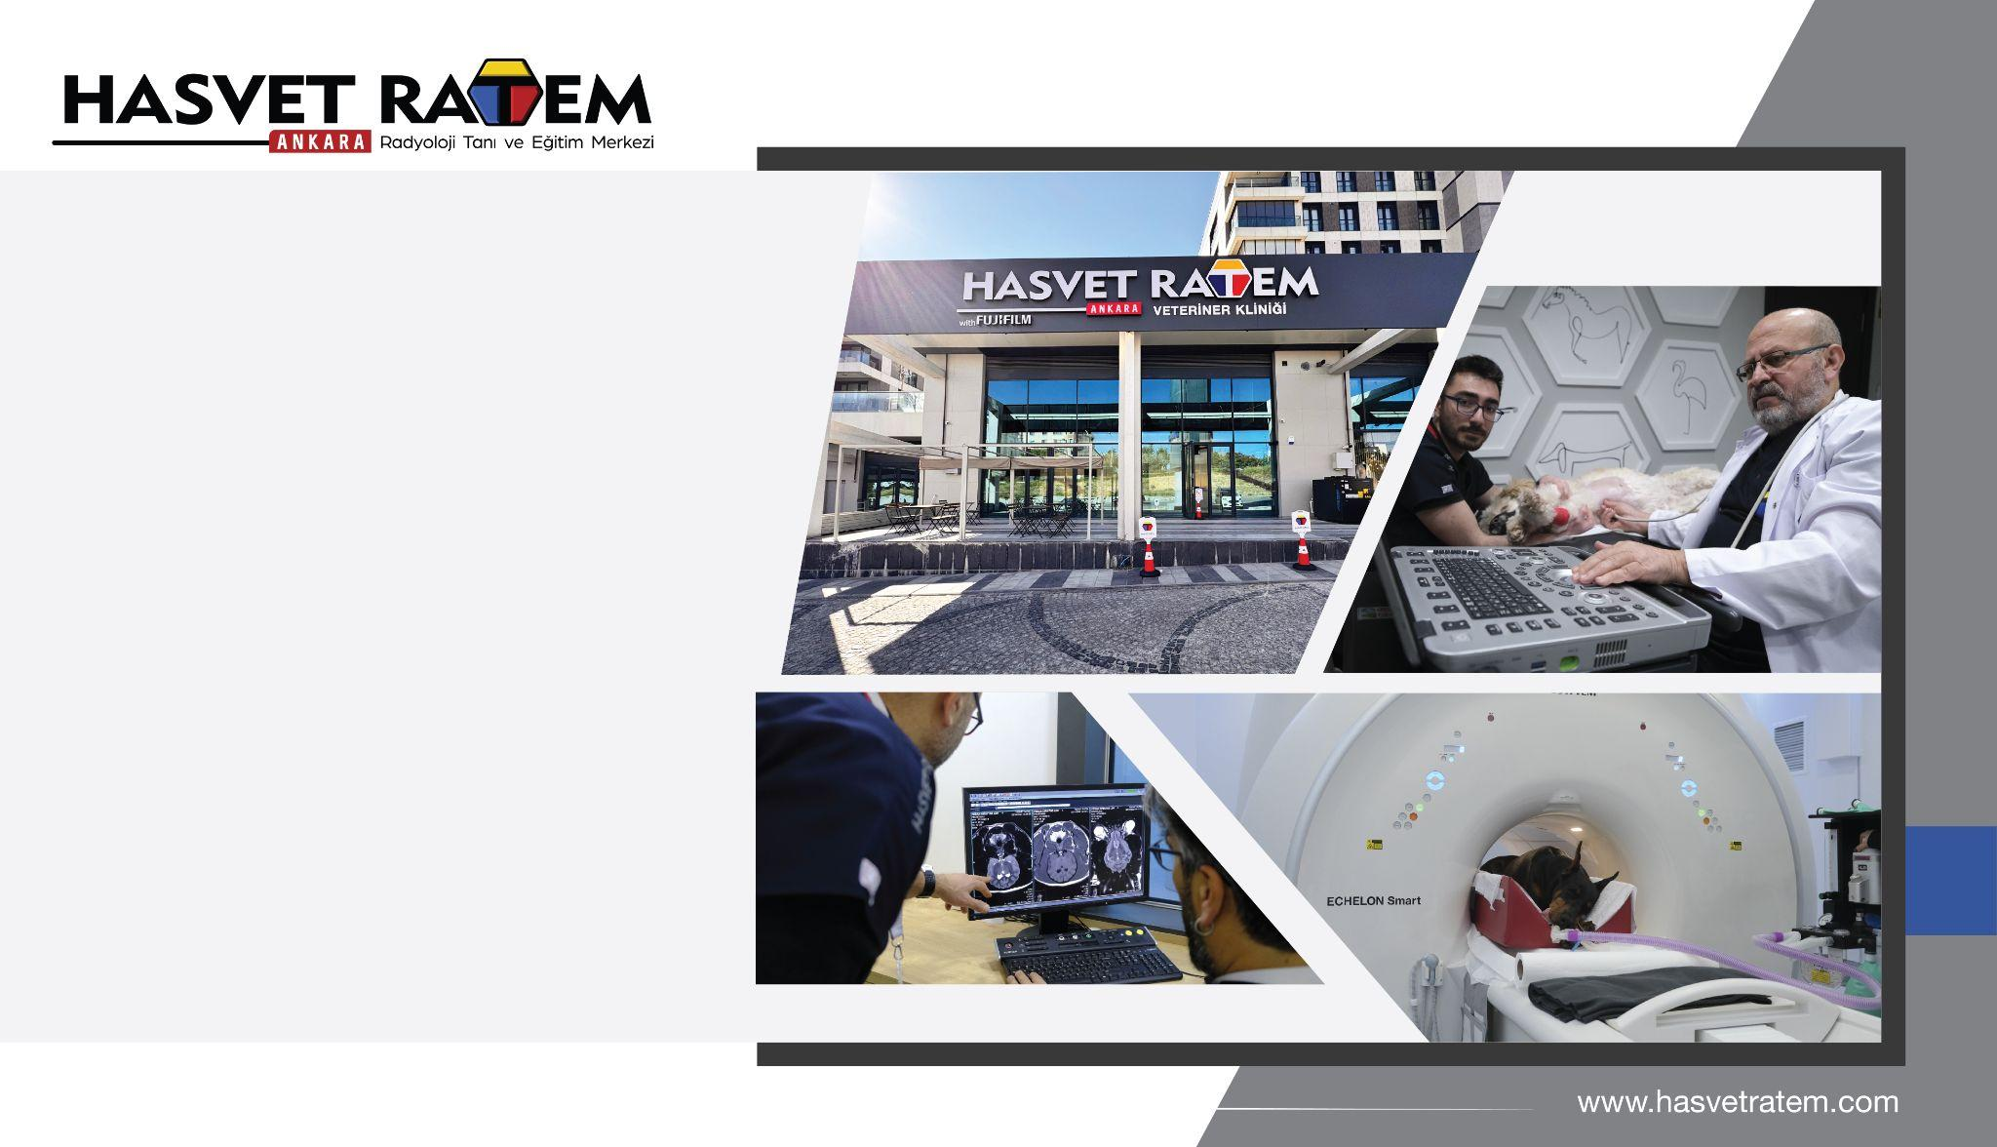
Hasvet Ratem Radiology Diagnostic and Training Center, after İstanbul, began providing diagnostic, imaging, and training services in Ankara in May 2025.
With case-based training programs and international collaborations, we are not only a diagnostic center but also an educational platform continuously supporting the professional development of veterinary practitioners.
Our Services Include:
MRI Imaging
Computed Tomography (CT)
Doppler Ultrasonography
Anesthesiology
Radiography
Endoscopy
EEG
EMG
Laboratory Services
Practical Training Facilities
Our center, which provides services only to veterinarians, offers solutions to cases with advanced technology equipment and field expert physicians, and organizes advanced, applied training with expert instructors from Turkey and abroad; We provide services in many fields such as MR Imaging, Computerized Tomography, Doppler Ultrasonography, Hemodiafiltration, Lithotripsy, Anesthesiology, Radiography, Endoscopy, EEG, EMG, Laboratory, Pathology Laboratory, along with a Special Operation Hall and Applied Training Areas.

Slide 34
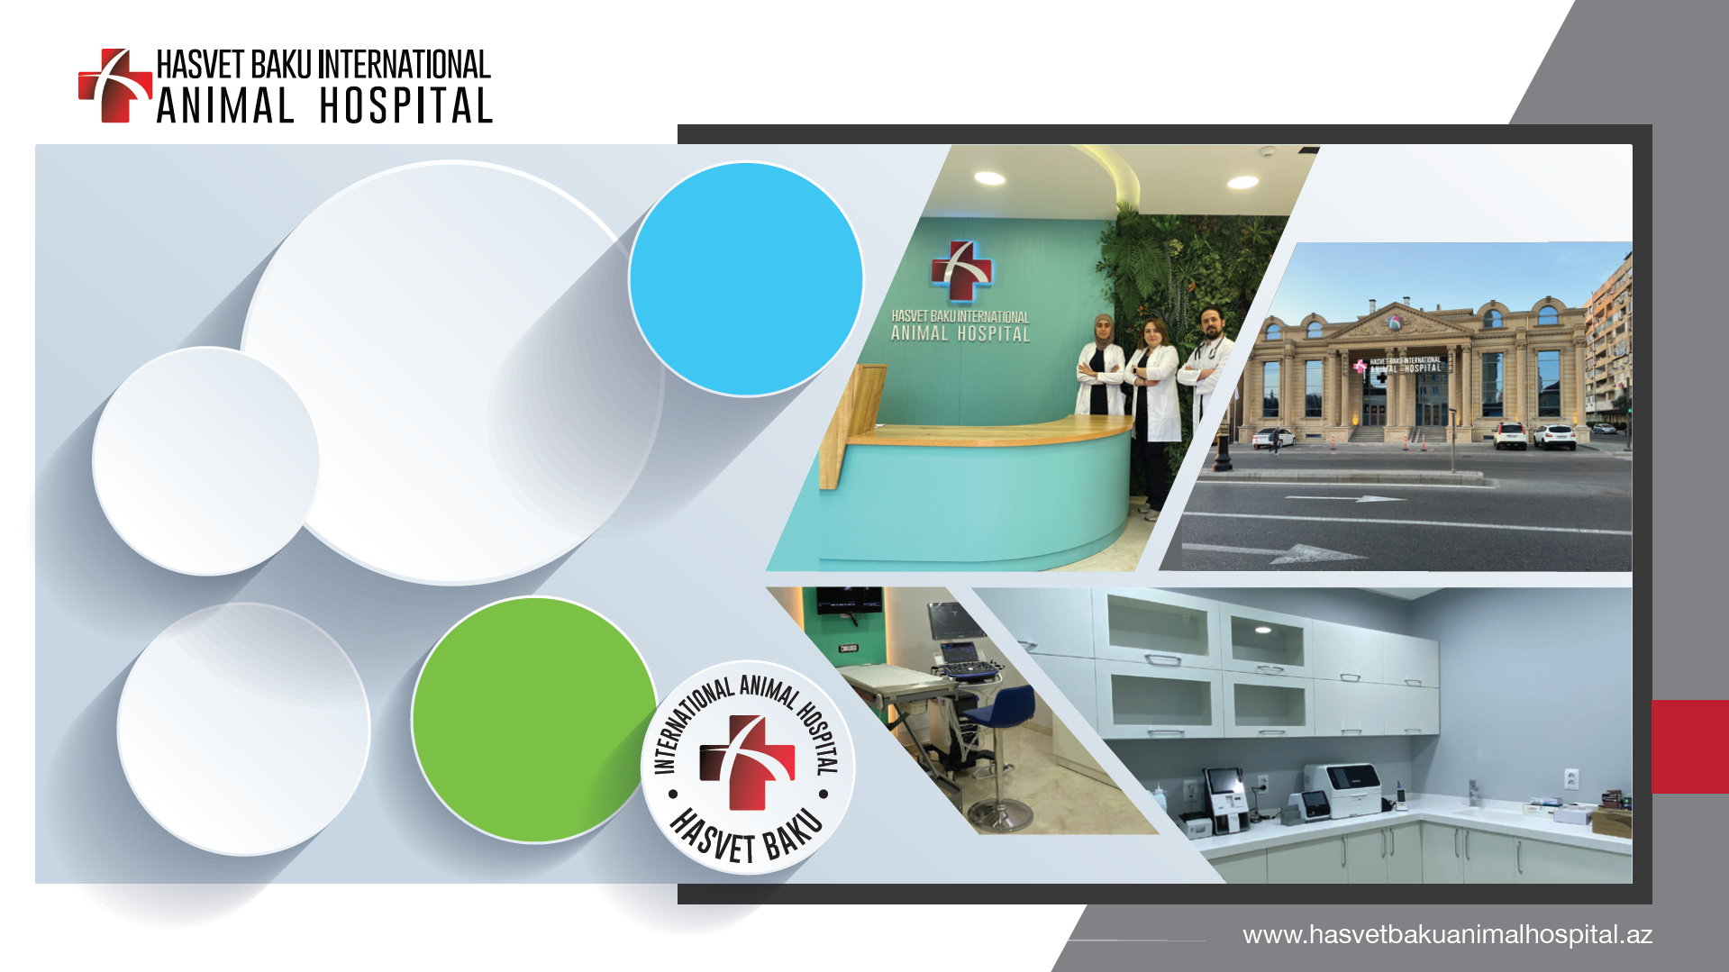
Ultrasonography
Digital X-Ray
Computed Tomography
Echocardiography
Endoscopy
Physiotherapy
Pet Shop
Pet Grooming
Oral and Dental Health
Eye Diseases
Cardiology
General Surgery
Obstetrics and Gynecology
Internal Medicine
Preventive Medicine and Vaccination

Slide 35
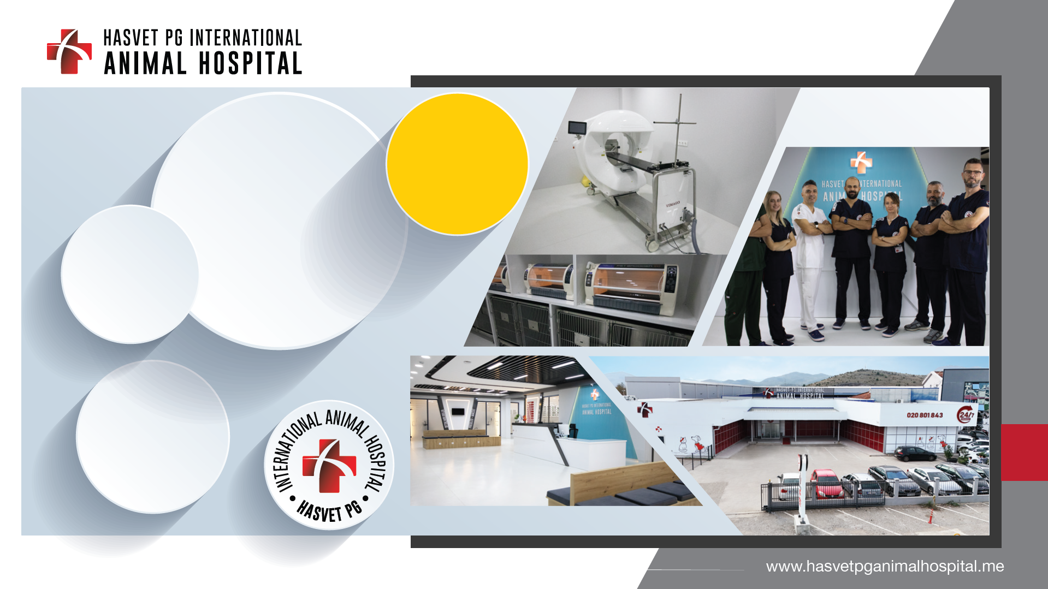
Ultrasonography
Digital X-Ray
Computed Tomography
Echocardiography
Endoscopy
Physiotherapy
Pet Shop
Pet Grooming
Oral and Dental Health
Eye Diseases
Cardiology
General Surgery
Obstetrics and Gynecology
Internal Medicine

Slide 36
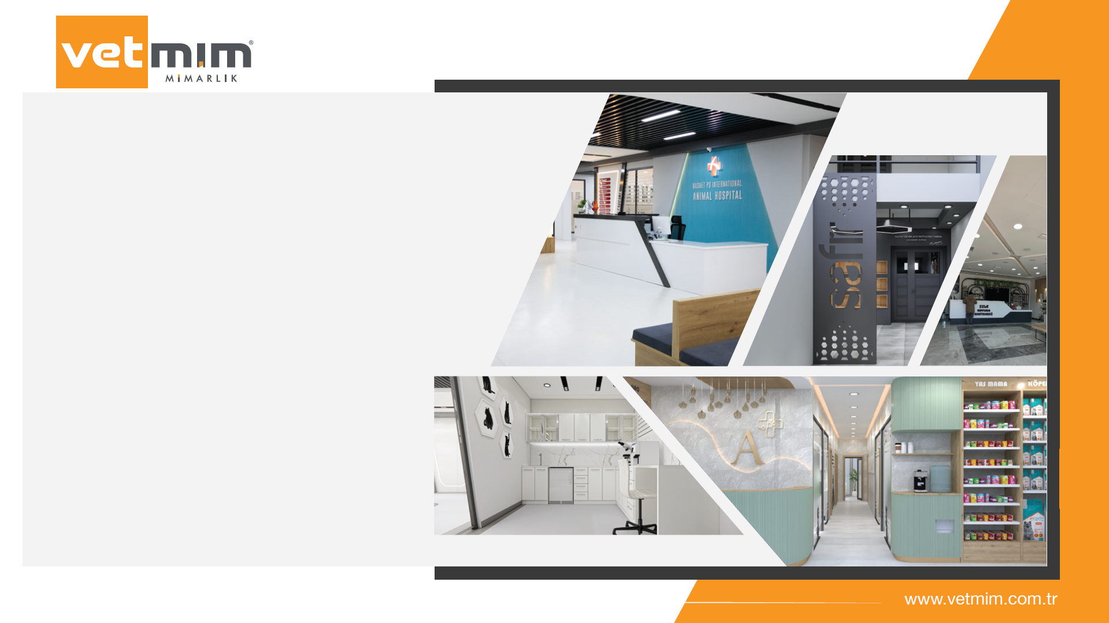
VetMim offers turnkey services for veterinary architectural projects, which have become one of the most important needs of the veterinary health sector in the world, with fear-free designs that comply with legislation and animal welfare.
As Hasvet A.Ş., the VetMim department, which we established in May 2021 on an area of ​​1200 m² in Antalya Altınova, has 2 architects, 2 site managers, 4 application teams and project partners in each province.
We have implemented many projects in a short time by providing design application and consultancy services with 2B design for many clinics.

Slide 37
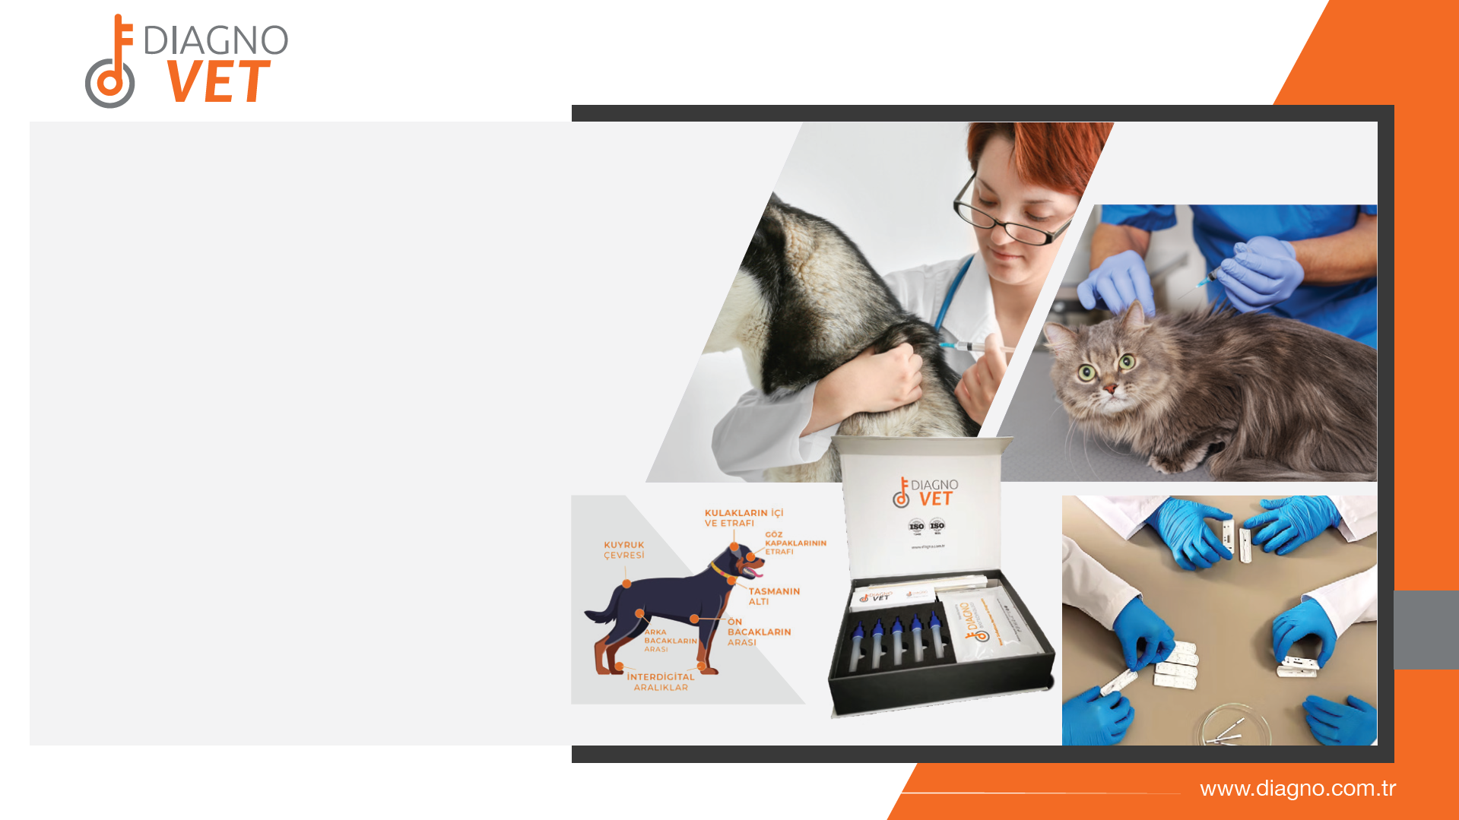
Diagno Biotechnology is a company specialized in diagnostic technologies.
The company develops and produces diagnostic kits and raw materials, focusing on affinity-based tests such as rapid tests (lateral flow tests, immunofiltration), ELISA, immunochromatography and biosensors.
It also offers innovative solutions to the sector by developing new affinity molecules such as antibodies and award-winning DiagnoBody molecules.

Slide 38
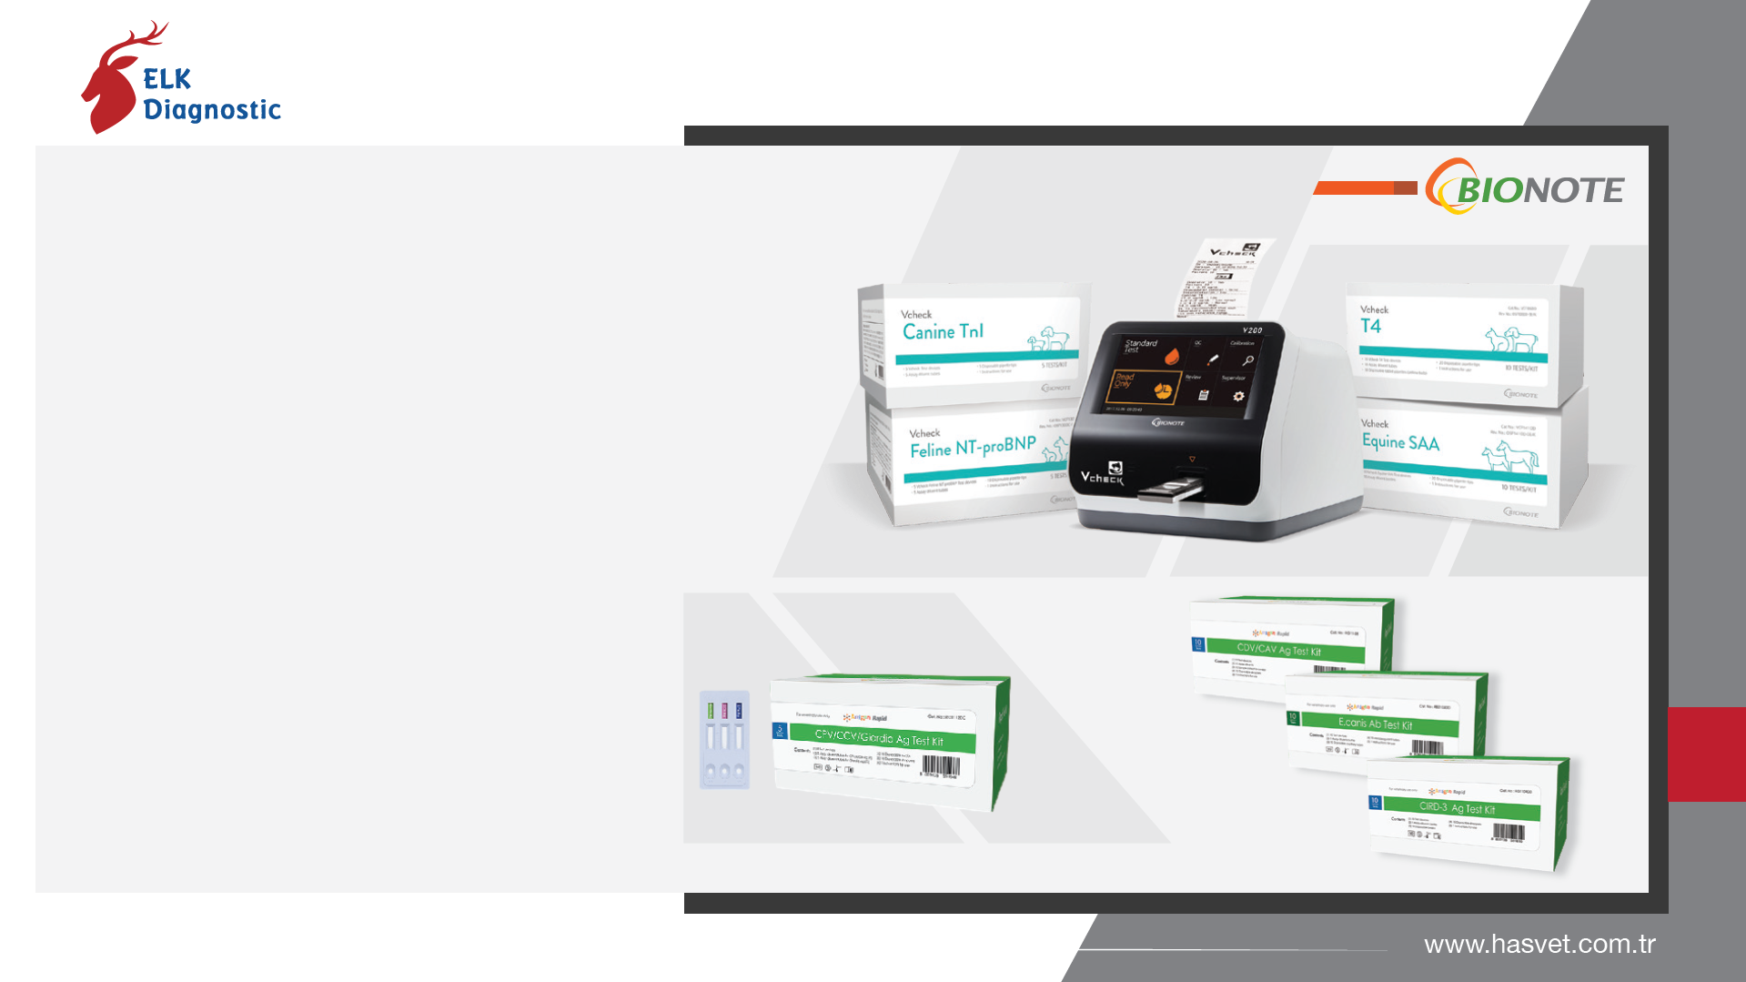
ELK Diagnostics aims to protect animal health at the highest level with rapid diagnostic kits and treatment support products containing advanced technology in the field of veterinary diagnostics.
As the sole authorized distributor of BIONOTE, one of the global leaders in veterinary diagnostics, it has a strong presence in the field. Our rapid diagnostic kits provide early diagnosis opportunities for veterinarians in the diagnosis of infectious diseases, zoonotic diseases and metabolic disorders, paving the way for effective treatment.

Slide 39
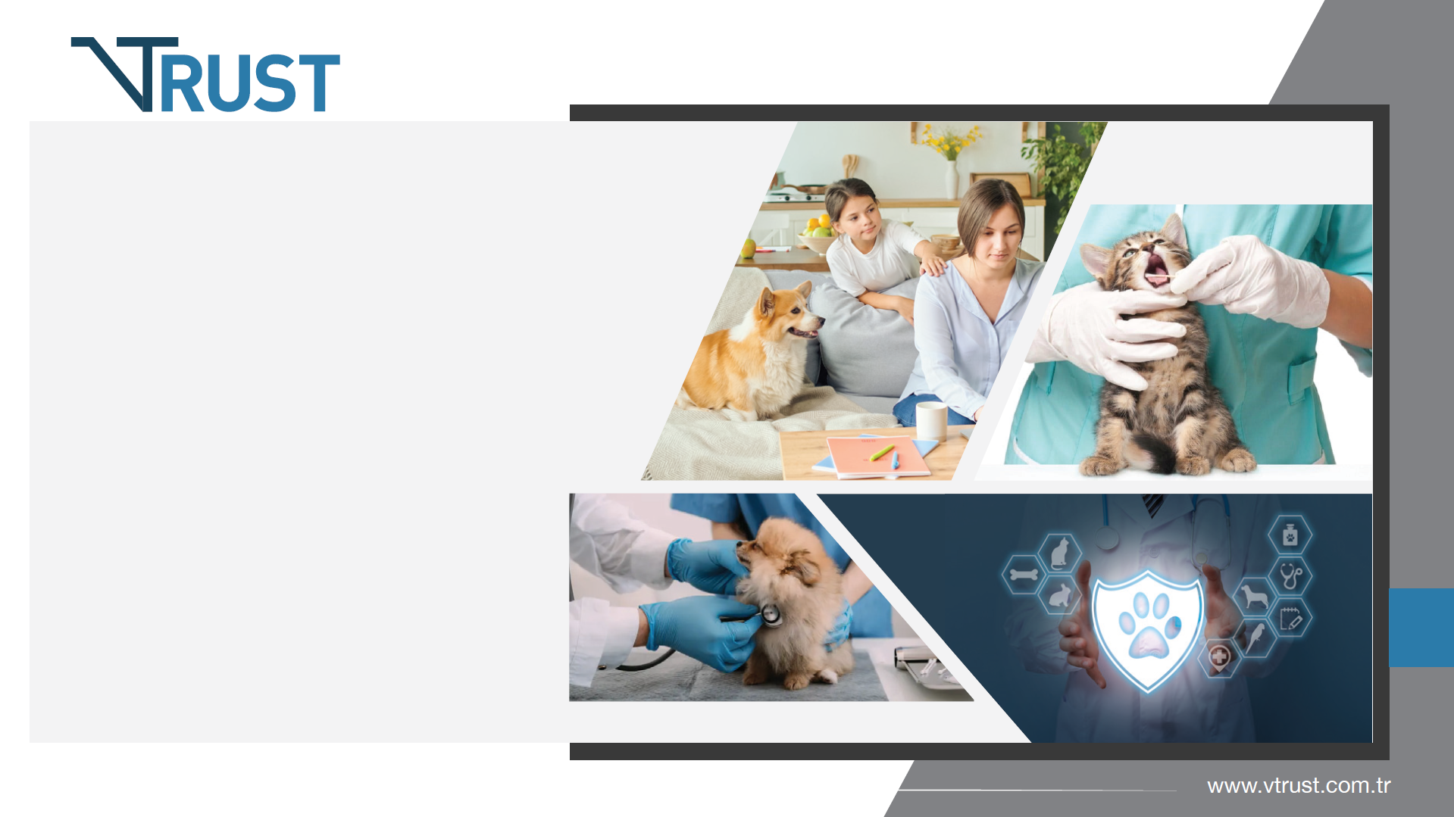
Vtrust pet insurance is an insurance company that covers the health expenses and unexpected risks of your pets such as cats and dogs. Similar to human health insurance, it offers comprehensive services to cover the veterinary expenses, treatment processes and possible third-party damages of animals. It helps pet parents who apply to contracted veterinary clinics to benefit from these services.

Slide 40
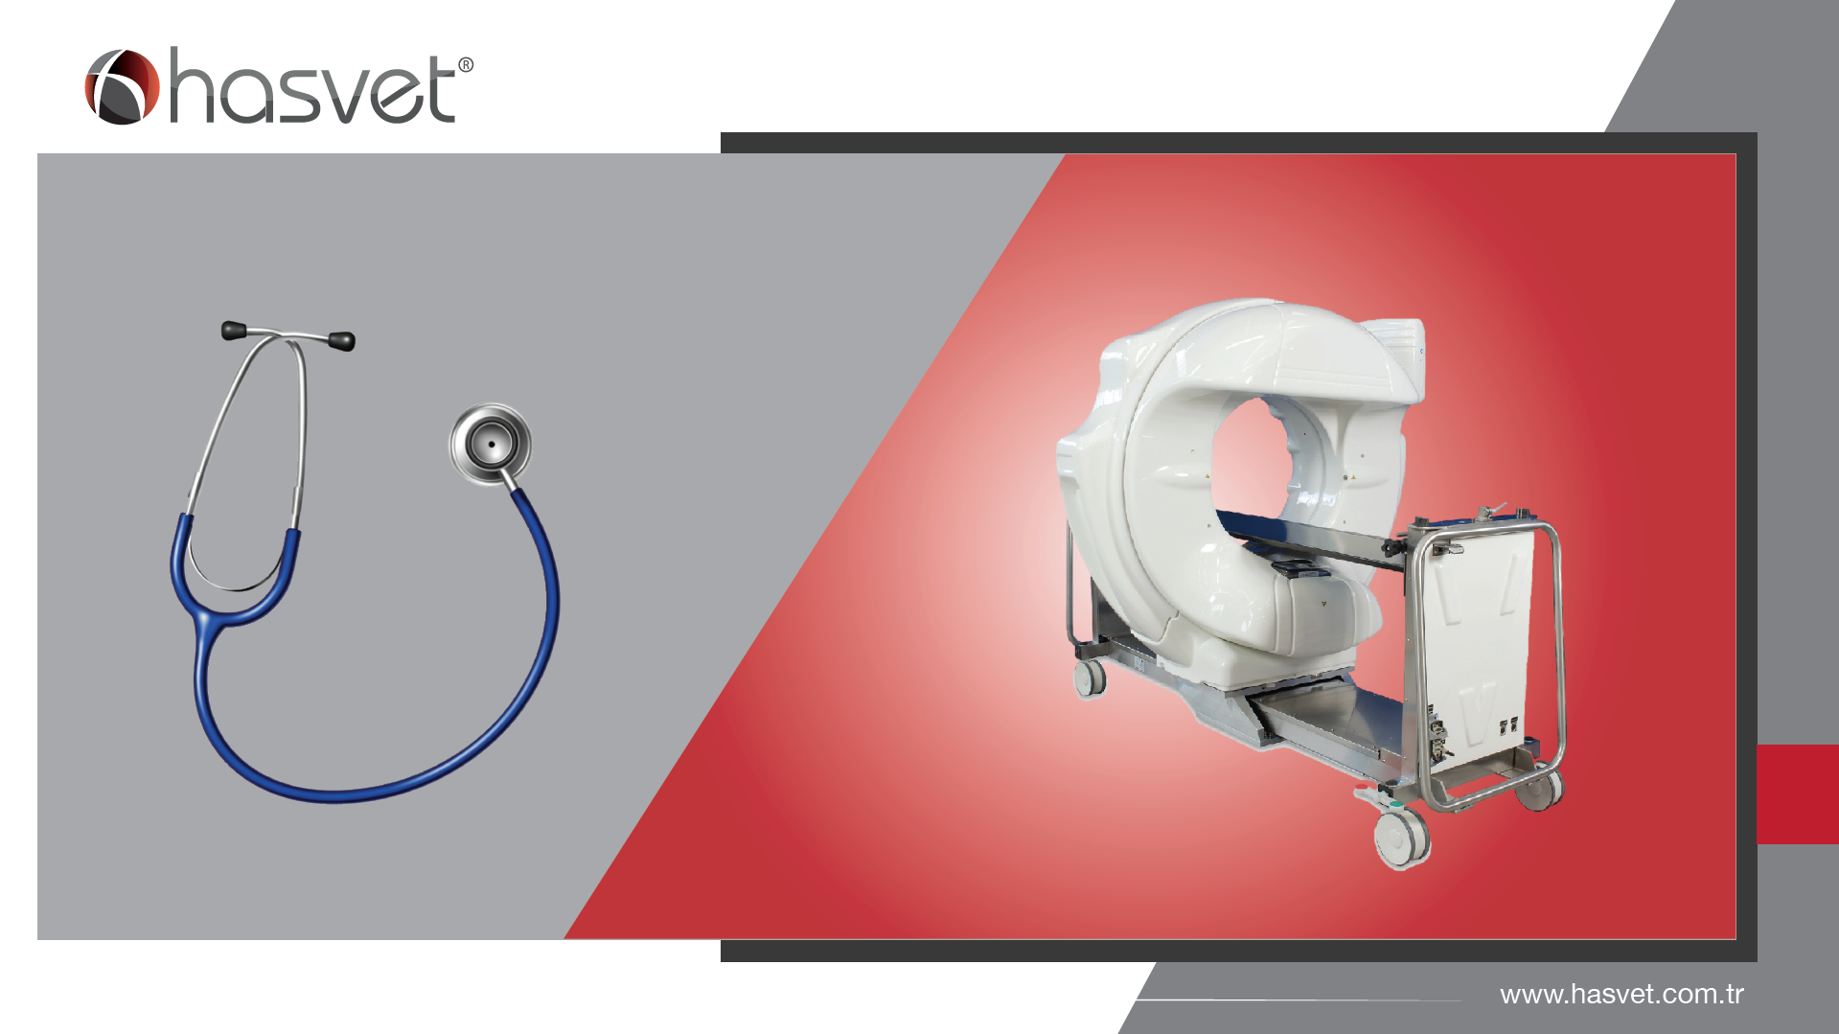

Slide 41

THANK YOU

